Slide 1

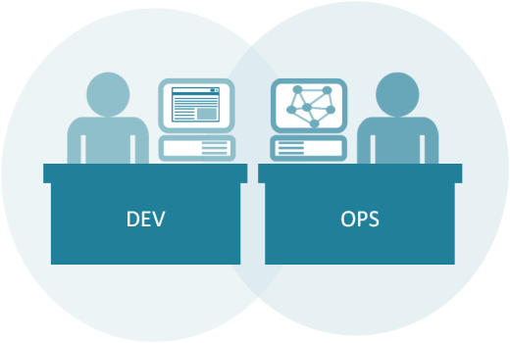
Microservices Engineering Boot Camp
64600M_3.0_2018

Slide 2
Welcome!
Logistics (breaks, facilities, lunch, etc.)
Rules of Engagement
Introductions
Let’s Get Started!
Notes:
Resources for running Kubernetes & practicing Microservices on a Microsoft cloud:
https://docs.microsoft.com/en-us/azure/container-service/kubernetes/container-service-kubernetes-windows-walkthrough
https://hackernoon.com/kubernetes-adventures-on-azure-part-2-windows-cluster-and-trick-for-scaling-pods-27e769edde15
A few key agenda items:
Microservice patterns – 1 service per container/per host
Database per container
Rete limiting
API Gateway
Strangler pattern
Convert monolith into Microservice
Customer model
Inventory service
Example: Spin up monolith and break it up

Slide 3

Who is your instructor today?
A little about me…

Slide 4
Introductions
What is your Name and Job Role?
Your company or team?
Expectations for the class?
Something interesting about yourself?

Slide 5
Core Objectives
Understand how to adopt, plan or improve your transition to Microservices
Navigate different tools for enabling Microservices and how to use them
Map technical practices to the business strategy behind Microservices
Get hands-on practice with tools which enable core Microservices architecture
Build more DevOps practices through Microservices adoption
Apply Microservices use cases to continuous integration, delivery and testing
Understand how to refactor monolithic systems into more modular, component-based systems

Slide 6
What to expect from this class
Flexibility
Conversations
Literacy and awareness on many of the principles, tools, and practices surrounding Microservices culture, architecture and implementation.
An effort to focus on your own situations and challenges so you can act on what you learn.

Slide 7
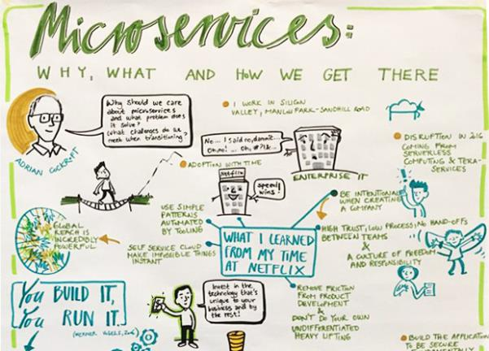
Part 1: Introduction to Microservices
Microservices is defined as a loosely-coupled, service-oriented architecture with bounded context.
Notes:
Recommended reading:
https://thenewstack.io/microservices-changed-matter/
Excerpt:
“…What works? It starts with the organization and the API: A microservices-based product team and a separate backend-based platform team with an API between them, where the API calls are made and the infrastructure responds consistently and accordingly.
Microservices is defined as a loosely-coupled, service-oriented architecture with bounded context. It allows updates without needing to understand how everything else works. Services are built across organizations, and ownership stays in one place. Microservices architecture serves more as point-to-point calls between systems. You must have flexible message formats; irrespective of the versions, everything still works. That means when building a microservices architecture, you need some tooling to configure, discover, route traffic and observe and build systems.
IBM’s Andrew Hately, distinguished engineer and chief technology officer for IBM Cloud Labs, offers the context that fifteen years ago, people might check their bank balance once a week. In time, the Internet allowed people to check their balances, and taking that accessibility further, smartphones drove, perhaps, the most change. Today, people can get instant access to every spend on their accounts. That speed and immediacy means that businesses have to respond with services that are developed on the same scale that the social networks and search companies developed their services on over the past five to ten years.

Slide 8

The Journey is a “Team of Teams”
“First I needed to shift my focus from moving pieces on the board to shaping the ecosystem.”
– General S. McChrystal, Team of Teams: New Rules of Engagement for a Complex World
McChrystal (US Army General) understood that the only way to scale the agility and speed of a small team to a scope that could be employed in a hierarchical organization of many thousands of people was to employ radical transparency and independent decision-making power that was decoupled from the approval of the command structure. This “team of teams” approach reduced silos and flattened the organization, allowing much greater speed and adaptability.
Notes:
General Stanley McChrystal’s book:
https://www.amazon.com/Team-Teams-Rules-Engagement-Complex/dp/1591847486
In this book General McChrystal explains how he and his senior staff reinvented the military task force to a model of decentralized decision making in the midst of a grueling war.
McChrystal understood that the only way to scale the agility and speed of a small team to a scope that could be employed in a hierarchical organization of many thousands of people was to employ radical transparency and independent decision-making power that was decoupled from the approval of the command structure. This “team of teams” approach reduced silos and flattened the organization, allowing much greater speed and adaptability.

Slide 9
Situation: Enterprise team building an enterprise app
Lets imagine a medium sized enterprise app that has a team with roughly
12 engineers
2 project managers
2 scrum masters
3 database engineers
8 UI engineers
2 engineering managers
1 UI engineering manager
1 QA manager
1 database engineering manager
2 directors
4 QA
36 individuals total, with 1/3 partially allocated to this and other projects

Slide 10
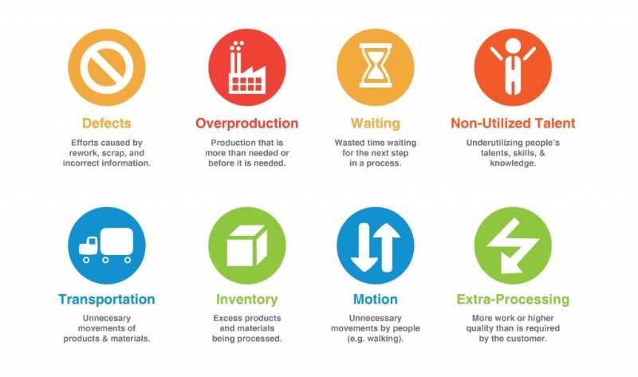
DevOps Foundation - Toyota Production System
8 Wasters

Slide 11
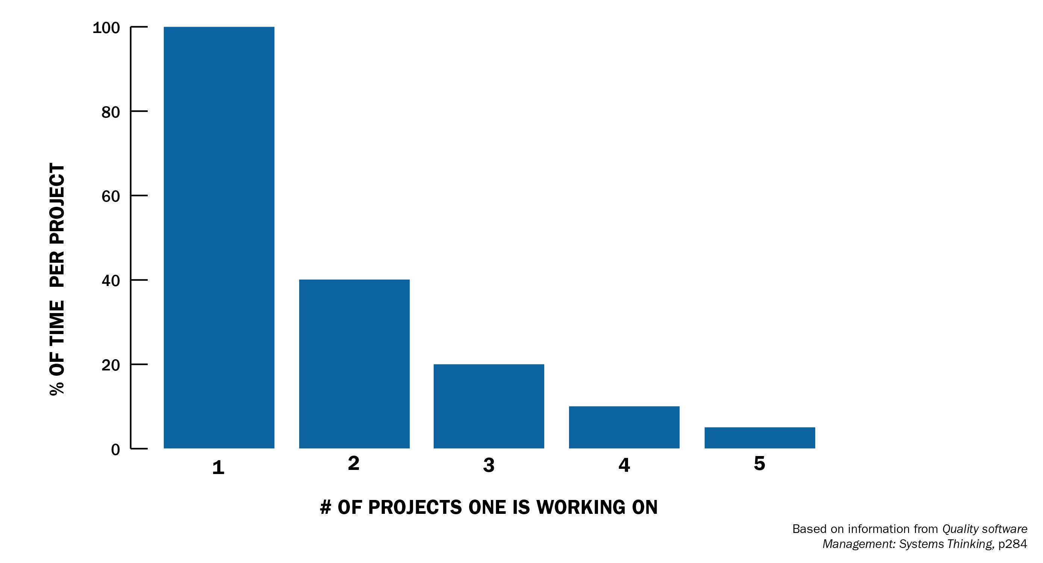
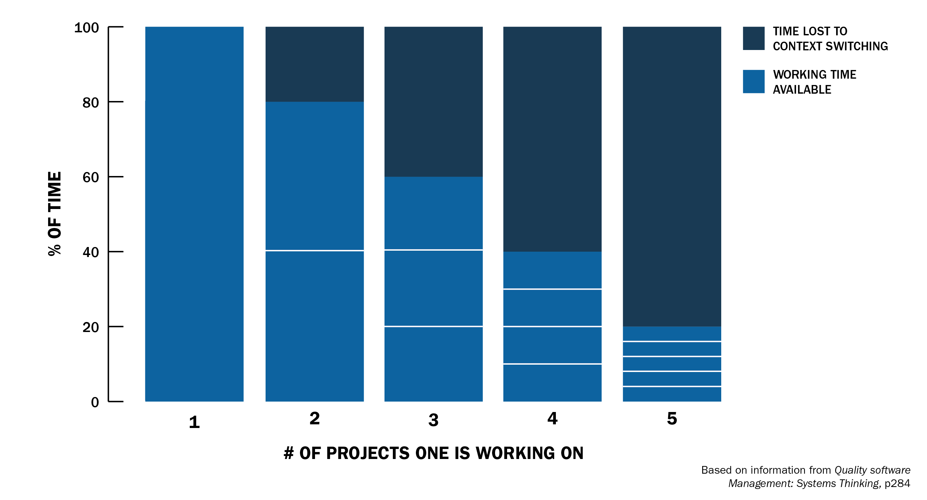
Complication: Context Switching is Expensive
According to the Software Engineering Institute at Carnegie Mellon University, context switching is extremely expensive.
Switching projects results in rapidly diminishing results
By implication, engineers manually tracking dependencies and switching to each manual task required for a specific service is similar in its impact on productivity
Given that dependencies assignments are clustered with dev leads handling 3-7 each, productivity can be heavily impacted
At 2 different tasks or projects, an engineer is losing 20% of their time to overhead. At 3 overhead jumps to 40%.
Any value over 3 results in losing the majority of a resource’s time to overhead and context switching
Frequently, staff is assigned to multiple projects and jumps between meeting, reporting and development activities
Notes:
https://insights.sei.cmu.edu/devops/2015/03/addressing-the-detrimental-effects-of-context-switching-with-devops.html
Joel Spolsky on the particular challenges of task-switching for programmers:
The trick here is that when you manage programmers, specifically, task switches take a really, really, really long time. That's because programming is the kind of task where you have to keep a lot of things in your head at once. The more things you remember at once, the more productive you are at programming. A programmer coding at full throttle is keeping zillions of things in their [sic] head at once: everything from names of variables, data structures, important APIs, the names of utility functions that they wrote and call a lot, even the name of the subdirectory where they store their source code. If you send that programmer to Crete for a three week vacation, they will forget it all. The human brain seems to move it out of short-term RAM and swaps it out onto a backup tape where it takes forever to retrieve.
Joel calls this the “task switching penalty.”

Slide 12
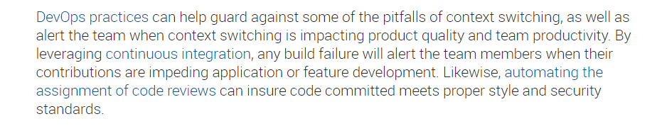
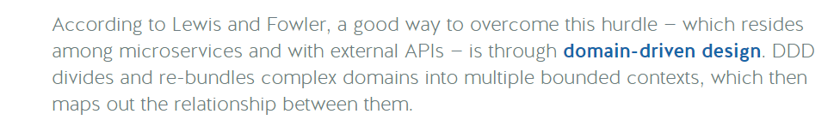
Complication: Context Switching is Expensive
Notes:
https://nordicapis.com/microservices-architecture-the-good-the-bad-and-what-you-could-be-doing-better/
https://blog.trello.com/why-context-switching-ruins-productivity
https://insights.sei.cmu.edu/devops/2015/03/addressing-the-detrimental-effects-of-context-switching-with-devops.html
https://particular.net/blog/microservices-future-or-empty-hype

Slide 13
Before diving into Microservices, let’s go through few aspects in DevOps.
DevOps – First way – Optimize Flow
DevOps – Second way – Amplify Feedback
DevOps – Third way – Continual Learning

Slide 14
Your DevOps Journey: Optimize Flow – First Way
Infrastructure As Code
Deployment Pipeline
Automated Testing
Continuous Integration
Containerization/Microservices
Architect for Low-Risk Releases

Slide 15
Your DevOps Journey: Amplify Feedback – Second Way
Telemetry: Metrics, Monitoring and Alerting
Use Telemetry to Anticipate Problems
Feedback for Safe Deployment of Code
Hypothesis-Driven Development
Change Review and Coordination

Slide 16
Your DevOps Journey: Continual Learning – Third Way
Learning culture
Blameless Postmortems
Innovation culture
Rehearsing Failures
Knowledge Sharing
Reserve Time for Organizational Learning

Slide 17
Situation: Executive leadership wants a roadmap, time to plan!
Fly everyone to one location
Lock the team in a meeting room for 4-5 days
Size and plan user stories for the next 10, 15, or 20 weeks using scaled agile or another agile methodology
Deliver roadmap to leadership!

Slide 18
Complication: Dependencies
Typical app in a good case will have approx. 15 dependencies on other development groups
Manual handoffs of data in file share drives
Sharing of data tables
Requisition of data center resources
Approval from internal security groups
Future creation of API’s
Often private and undocumented

Slide 19
Complication
With no mechanism to reduce complexity, the application grows more complex
Add dependencies
Add features
Add Security
Etc.

Slide 20
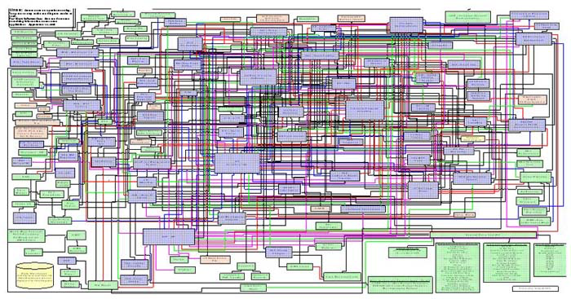
The Hairball
Deployment ??
Scaling ??
Updates ??
Complex App

Slide 21
Complication: Deploying the complex app is hard
Updates are less frequent
Velocity slows
Long QA cycles
Multiple development teams must coordinate deployment and releases
FEAR of new features

Slide 22
Complication: Scaling the complex app is hard
We must scale the monolith, but it is highly coupled
The best option is often to place it in a larger server (more CPU, memory)
Typically very expensive to scale vertically
Application becomes more vulnerable to outage and downtime

Slide 23
Complication: Updating the complex app is hard
Long term commitment to technology choices
Slow application startup times can drag down developer velocity as well
Cost increases
Perhaps fall behind newer competitors implementing on new technologies
In 1965, the average tenure of companies on the S&P 500 was 33 years. By 1990, it was 20 years. It's forecast to shrink to 14 years by 2026.
About 50 percent of the S&P 500 will be replaced over the next 10 years

Slide 24
Resolution: Microservice Architecture
Resolution: Create a Loosely Coupled API Service Platform, aka “Microservices”
Decentralize planning and eliminate interdependencies
This will make it possible for a team of developers to conduct their planning and development in isolation, vastly improving time to market and cutting cost.
A team of 7 planning without dependencies, with all the personnel required can reasonably plan for 10 weeks in a 1-2 days which would result in agile planning event savings alone of 50%
Skeptical? Consider a new team developing on Public Cloud (a Loosely Coupled API Service Platform)
(+) For example, a new development team on Cloud can submit API calls to create a VM, configure security routes, setup a firewall and create a database within minutes.
(-) The same operations within a common large enterprise often requires a complicated set of tickets and sophisticated connections to manage the hand-offs taking weeks to get started

Slide 25
Resolution: Microservices
Microservices enable Platforms
A platform is an ecosystem of APIs that third parties may build functionality on top of.
Notable Microservice Platform examples: Hootsuite, Gilt Group, SoundCloud, Amazon Web Services, Netflix, Spotify, Google Cloud, Box, and more!

Slide 26
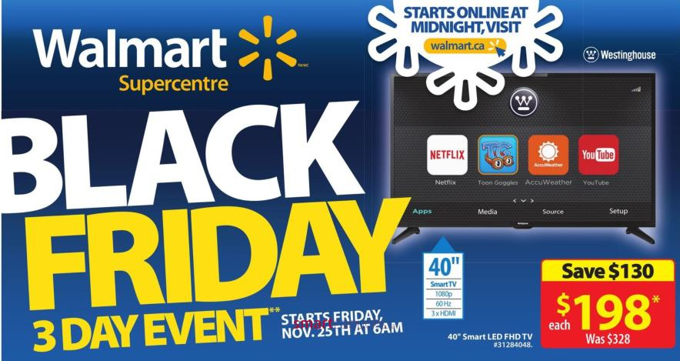
Walmart Canada Case Study
Notes:
The next few slides relate how Walmart Canada transitioned to microservice patterns using the following rubric for priorities:
They needed a new platform which was:
Message-driven (distribution, location transparency, isolation)
Resilient (supervision, dedicated separate error channel)
Elastic (scale up, async, non-blocking, scale out, immutable data, share nothing)
Responsive (responsive to events, load, failure, users, embrace new concepts and patterns, cluster computing, distribution of data, new patterns like circuit breakers)

Slide 27
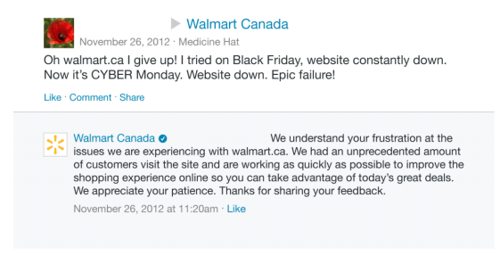
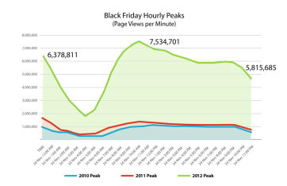
Walmart Canada: Situation
Designed in 2012, Walmart Canada’s website failed on Black Friday for two years in a row.
Traffic was increasing every year, keeping the team off balance
Customer backlash, competitive pressures (i.e. Amazon) made this a top priority

Slide 28
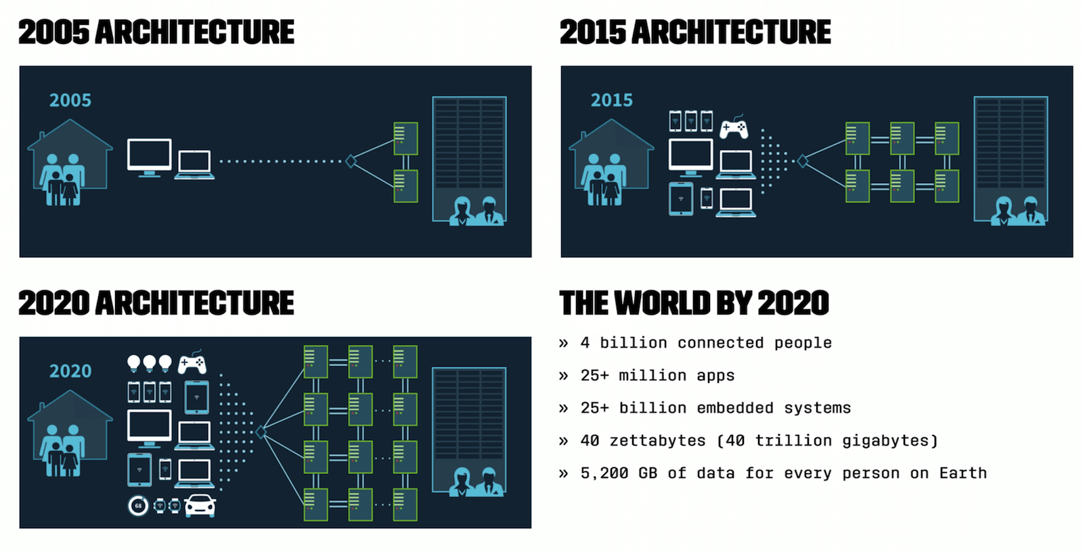
Walmart Canada: Action
With traffic likely to continue to increase, goals were set
Near 100% availability
Consistent responsiveness under varying load conditions
Predictable spikes of traffic e.g. Black Friday
Less predictable spikes e.g. marketing campaign

Slide 29
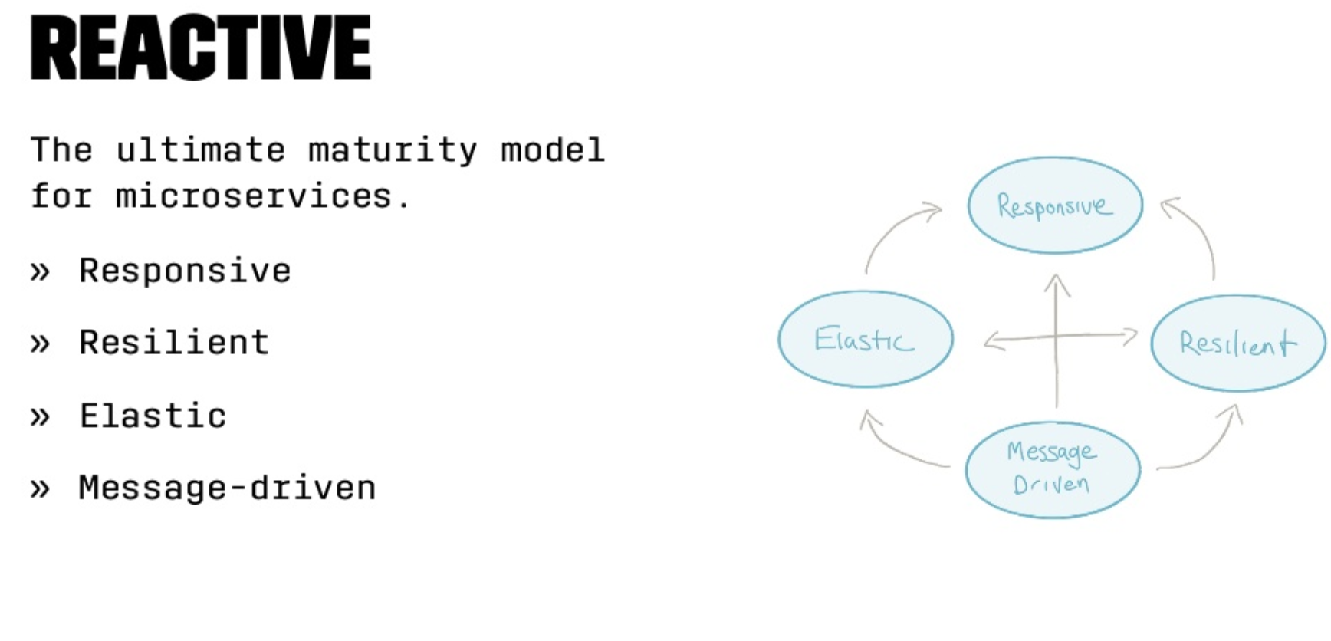
Walmart Canada: Action
Re-architected solution

Slide 30
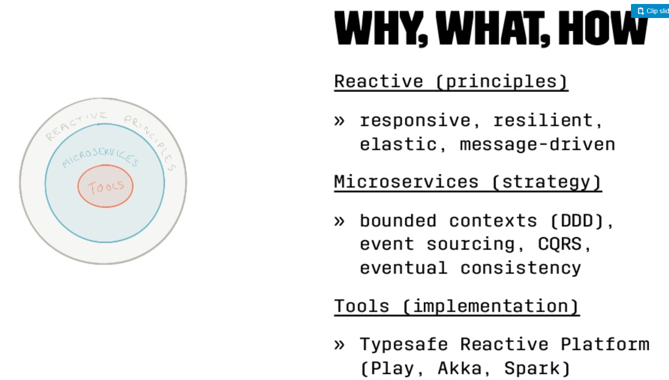
Walmart Canada: Action

Slide 31
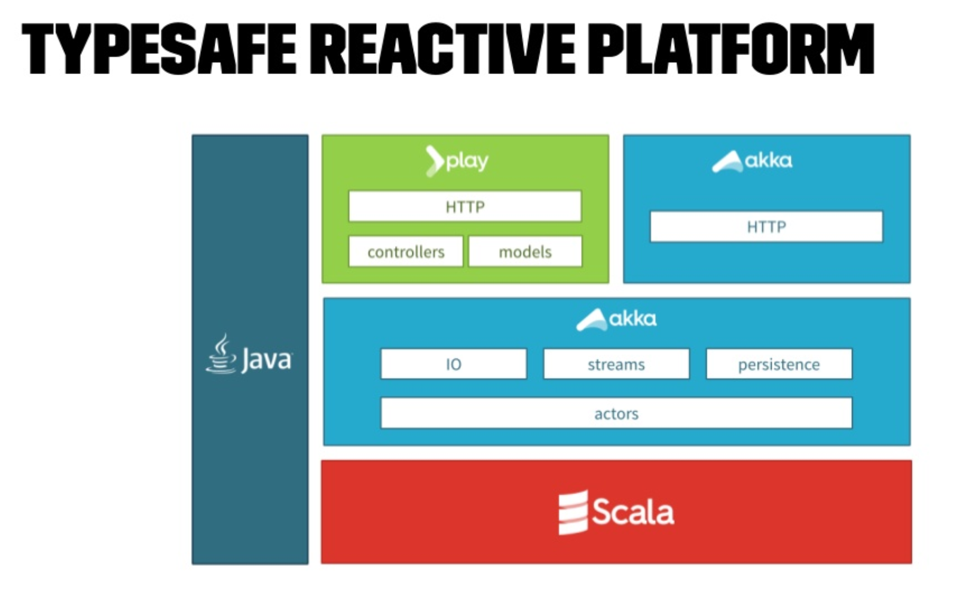
Walmart Canada: Action

Slide 32
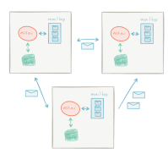
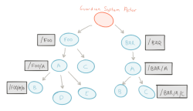
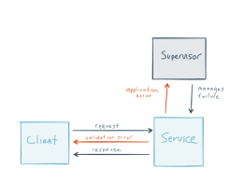
Walmart Canada: Action
Re-architected solution
Message Driven
Distribution
Location transparency
Isolation
Resilient
Supervision
Dedicated separate error channel

Slide 33
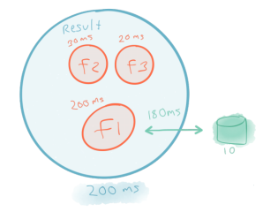
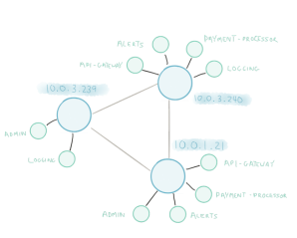
Walmart Canada: Action
Elastic
Scale up
Async
Non-blocking
Scale out
Immutable data
Share nothing
Responsive
Responsive to events, load failure, users
Distribution of data
Circuit Breakers

Slide 34
Walmart Canada: Result
Business Uplift
Conversions up 20%
Mobile orders up 98%
No downtime on Black Friday or Boxing Day
Operational Savings
Moved off expensive hardware
Cheap virtual x86 servers
20-50% cost savings
~40% compute cycles
Notes:
References:
https://www.slideshare.net/kvnwbbr/revitalizing-walmarts-aging-architecture-for-web-scale
https://www.youtube.com/watch?v=SPGCdziXlHU

Slide 35
How to break an application into Microservices?
Based on existing system and natural architectural boundaries
Database can be exposed as a Microservice for example
Any slow process behind a queue can be considered a Microservice
Language boundaries are an opportunity for Microservice creation

Slide 36

Strategy for legacy monoliths: The Strangler Pattern
https://flic.kr/p/nMWBkR
Notes:
The ’Strangler’ Pattern, as described by Martin Fowler. The pattern involves gradual replacement of a system by implementing new features in a new application that is loosely coupled to an existing system. Porting existing functionality from the original application only where necessary.

Slide 37
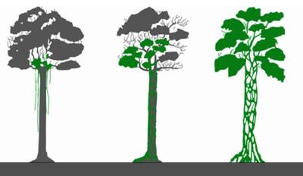
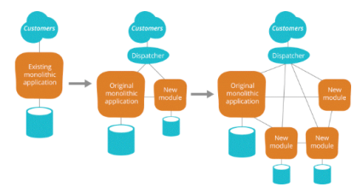
Strategy for legacy monoliths: The Strangler Pattern
Gradually replace a legacy system by implementing new features of an existing system with those in one or several new systems
Rather than trying to replace a large, expensive legacy system all at once you can iterate and improve in small amounts.
This can be implemented for example by a load balancer in front the targeted functionality
Over time, the old application is ‘strangled’ like a tree that has hosted a Strangler Fig.
Focus on quick wins, needs that were not satisfied by existing software to deliver the most value quickly.
Notes:
Talking points for stakeholders – key benefits:
One big benefit of this pattern is that is much more likely to get approved. Enterprises will debate replacing a large legacy system for years, but a team can deliver a quick prototype that replaces a single feature in a sprint. This effort can be built upon and a difficult legacy software component can be replaced in a more iterative and natural manner.
Another benefit is the deployability of new components. Ideally building them on a PaaS or other rapid development infrastructure.
SSD interfaces that external people use. For use to make changes we have to make sure we do not break the drives.
External customer wants a feature? Lightweight showcasing on the microservice platform is a great way to greenlight.

Slide 38
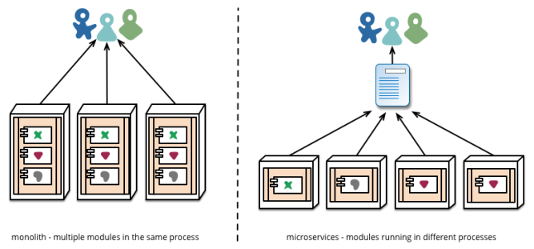
What is a Microservice?
A service that can be independently deployed
Notes:
Reference: https://martinfowler.com/articles/microservices.html

Slide 39
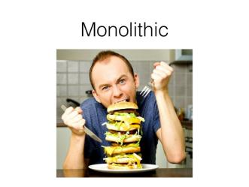
How big is a Microservice?
A single programmer can design, implement, deploy and maintain a Microservice – Fred George
Software that fits in your head – Dan North

Slide 40
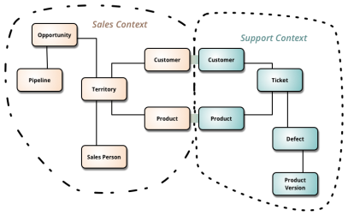
Where is the data for a Microservice?
A single logical database per service – Chris Richardson
A Microservice implements a single Bounded Context; Data model is driven by the domain model (DDD)
Event driven data Management
Notes:
Reference: https://martinfowler.com/bliki/BoundedContext.html
https://www.nginx.com/blog/event-driven-data-management-microservices/

Slide 41
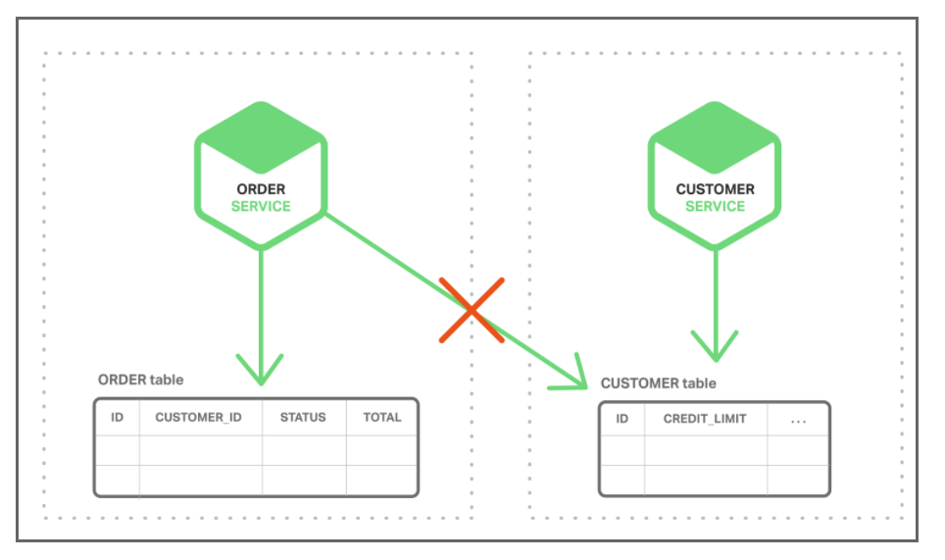
Event Driven Data Management
Implement business transactions that maintain consistency across multiple services
Implement queries that retrieve data from multiple services
Notes:
https://www.nginx.com/blog/event-driven-data-management-microservices/

Slide 42
Event Driven Data Management
Microservice publishes an event when something notable happens, such as when it updates a business entity. Other microservices subscribe to those events. When a microservice receives an event it can update its own business entities, which might lead to more events being published.
use events to implement business transactions that span multiple services
Notes:
https://www.nginx.com/blog/event-driven-data-management-microservices/

Slide 43
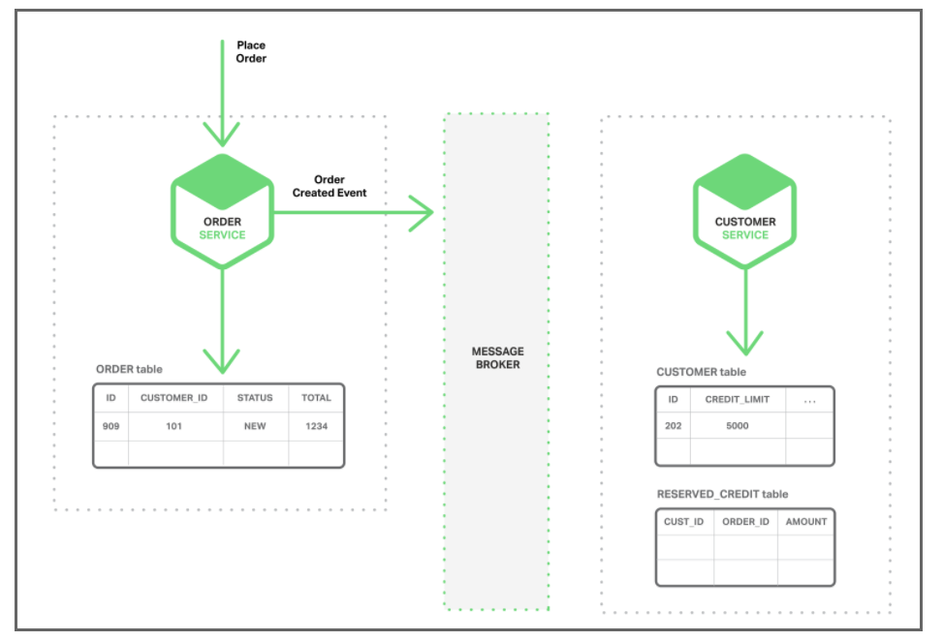
Event Driven Data Management
1. The Order Service creates an Order with status NEW and publishes an Order Created event.
Notes:
https://www.nginx.com/blog/event-driven-data-management-microservices/

Slide 44
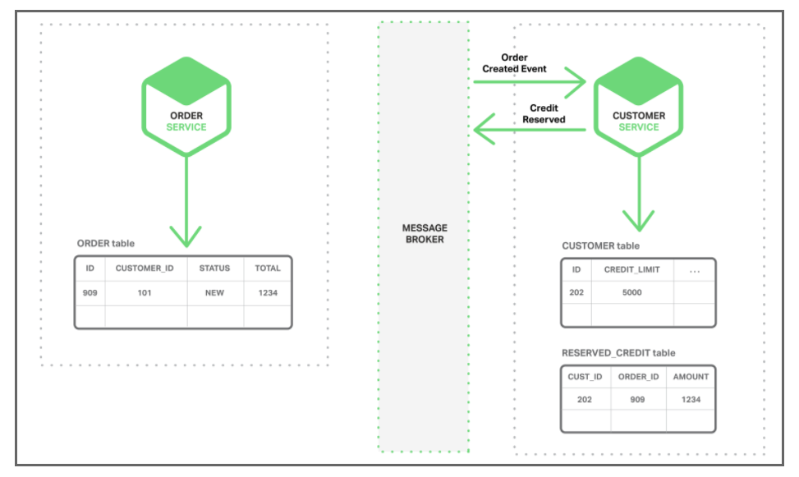
Event Driven Data Management
2. The Customer Service consumes the Order Created event, reserves credit for the order,
and publishes a Credit Reserved event.
Notes:
https://www.nginx.com/blog/event-driven-data-management-microservices/

Slide 45
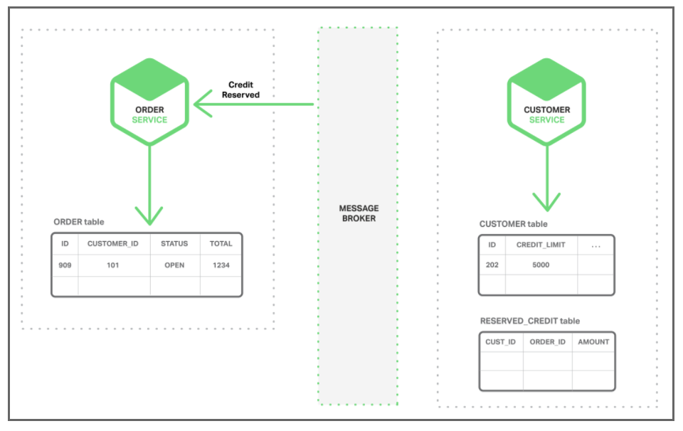
Event Driven Data Management
3. The Order Service consumes the Credit Reserved event, and changes
the status of the order to OPEN.
Notes:
https://www.nginx.com/blog/event-driven-data-management-microservices/

Slide 46
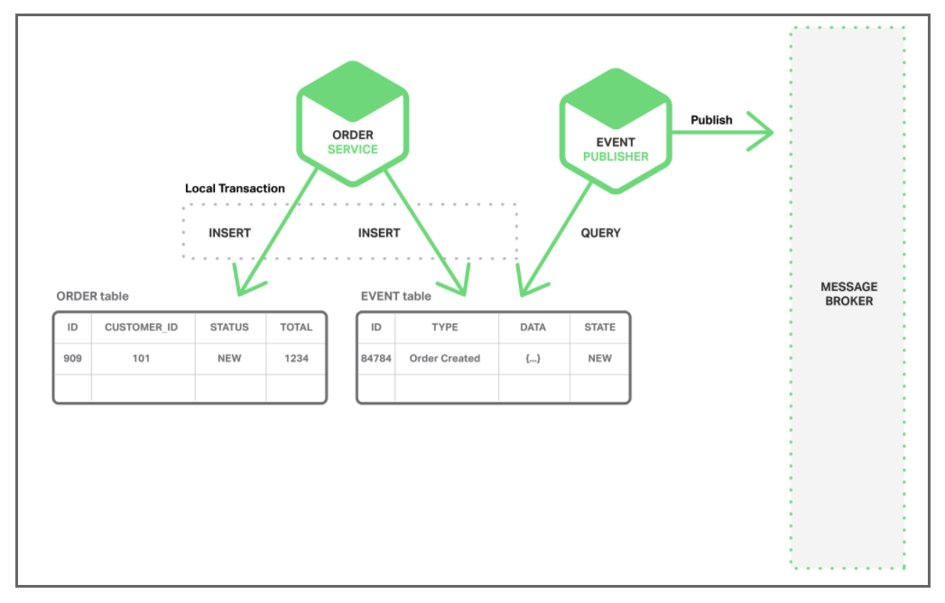
Event Driven Data Management - Preserve Atomicity
EVENT table -- functions as a message queue, in the database that stores the state of the business entities. The application begins a (local) database transaction, updates the state of the business entities, inserts an event into the EVENT table, and commits the transaction. A separate application thread or process queries the EVENT table, publishes the events to the Message Broker, and then uses a local transaction to mark the events as published.
Notes:
https://www.nginx.com/blog/event-driven-data-management-microservices/

Slide 47
How to maintain Microservices?
Addressable through a service discovery system – Chris Richardson
Microservices built & deployed independently. Stateless, with state as backing services – 12Factor.net
** Service Discovery – Will discuss in “Patterns”
Notes:
https://www.nginx.com/blog/service-discovery-in-a-microservices-architecture/

Slide 48
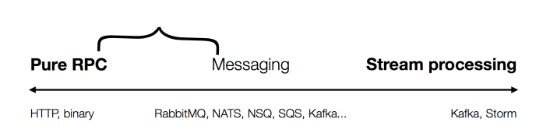
How to architect Microservices?
Typically
CRUD – Create, Read, Update and Delete API implementations
Range between RPC, Message and Stream processing
Evolve from a Monolith 1st iteration

Slide 49
Microservice: Advantages
Simple services that are focused on doing one thing well
Each service can be built using the best tool for the job
Systems built this way are inherently loosely coupled
Teams can deliver and deploy independently from each other
Enable continuous delivery but allowing frequent releases while the rest of the system continues to be stable
Notes:
Can be (but not always)
< 6000 lines
Reference: https://martinfowler.com/articles/microservices.html

Slide 50
Microservices
Solve organizational problems
Teams blocked by or waiting on other teams
Communication overhead
Slow velocity
Cause Technical Problems
Requires Devops, devs deploying and operating their services
Need well defined business domains
More distributed systems
Need an orchestration layer

Slide 51
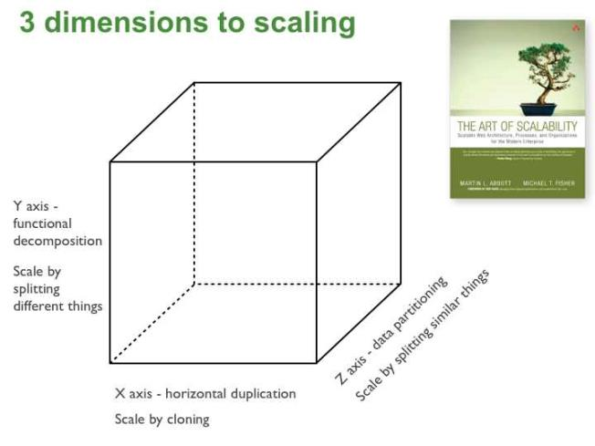
The Art of Scaling
Decrease complexity
More resource efficient
Complex structure,
but enables scalability
Doesn’t decrease complexity,
but scales
Notes:
Reference: http://microservices.io/articles/scalecube.html
X-axis: Run multiple copies behind a load balancer
Pros
Simple
Cons
Doesn’t decrease complexity
Often limited by state not being effectively shared between instances
Y-axis: Splits the application into multiple different services
Pros
Decreases complexity
Most resource efficient
Cons
Requires intentional effort
Z-axis: Split application into different segments of data
Pros
Most memory resource efficient
Enables scalability
Cons
Most complex
Difficult to refactor

Slide 52
Self Service Mandate (Build a Platform)
All teams will expose their data and functionality through self service Api interfaces
No other forms of communication allowed, no tickets, direct linking, reads of data stores, no back doors, only service interface calls over the network
All services must be designed to be externalizable. The team must plan and design to be able to expose the api’s to developers in the outside world, creating a platform.
The now-famous Jeff Bezos rant, leading to formation of Amazon Web Services https://gist.github.com/chitchcock/1281611

Slide 53
Devops = Optimize for Speed
“Therefore, broadly speaking, to achieve DevOps outcomes we need to reduce the effects of functional orientation (“optimizing for cost”) and enable market orientation (“optimizing for speed”).”
-Gene Kim
This consists of having many small teams work independently, rapidly delivering customer value
Teams are cross-functional and independent. Each team, consisting of 8 or fewer resources, deploys independently.
Market oriented teams are responsible for feature development, testing, securing, deploying, and supporting service in production
Notes:
Reference: http://itrevolution.com/conways-law/

Slide 54
Microservices = Optimize for Speed
“Organizations with these types of service-oriented architectures, such as Google and Amazon, have incredible flexibility and scalability. These organizations have tens of thousands of developers where small teams can still be incredibly productive.”
-Randy Shoup, former Engineering Director for Google App Engine
This consists of having many small teams work independently, rapidly delivering customer value
Notes:
Reference: http://itrevolution.com/conways-law/
“Today, when organizations measure and optimize their activities, time to value is becoming a dominant metric.” – Adrian Cockcroft

Slide 55
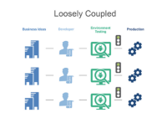
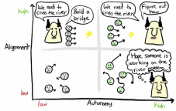
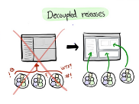
Small Team Size
Build platform with small teams of 6-8 engineer teams
Self Sufficient: Each team completely owns one or more services and has everybody they need to develop functionality
Automate Interfaces: Teams connect to each other through API’s. Teams don’t hire an army of program managers to manage dependencies.
Decentralized: Teams plan, develop and deploy autonomously
Starting and Scaling DevOps in the Enterprise by Gary Gruver https://www.amazon.com/dp/B01M332BN2/ref=dp-kindle-redirect?_encoding=UTF8&btkr=1
Notes:
Reference: https://clusterhq.com/2016/03/22/microservices-spotify-petter-mahlen
“There’s a yearly survey about what sucks about Spotify’s infrastructure. In 2015 service DB, the predecessor showed up as, I think, number 3 in what sucks. Whereas now, in 2016, System-Z is one of the things that gets the most frequent, “It’s great!” Even though we’re asking what sucks. “
“Another interesting thing we noticed is that it leads to teams building related features, infrastructure teams building related features, like an example is the team that owns hardware and provisioning, the team that owns DNS infrastructure, and the team that owns System-Z together have built like an improved version of how you do provisioning and deployment. “

Slide 56


Why Small Team Size? Scaling the Organization
Autonomy
Decentralizes power and creates autonomy which is critical to scaling the organization
Each team can focus on the business metric they are responsible for and act autonomously to maximize the metric.
Amazon CTO Werner Vogels explained the advantages of this structure to Larry Dignan of Baseline in 2005 (see notes accompanying this slide)
Science behind why two-pizza team works http://blog.idonethis.com/two-pizza-team/ ITRevolution, Conways Law by Gene Kim http://itrevolution.com/conways-law/
Notes:
Amazon CTO Werner Vogels explained the advantages of this structure to Larry Dignan of Baseline in 2005.
Dignan writes:
“Small teams are fast…and don’t get bogged down in so-called administrivia….Each group assigned to a particular business is completely responsible for it….The team scopes the fix, designs it, builds it, implements it and monitors its ongoing use. This way, technology programmers and architects get direct feedback from the business people who use their code or applications—in regular meetings and informal conversations.”
References:
http://blog.idonethis.com/two-pizza-team/
http://itrevolution.com/conways-law/

Slide 57
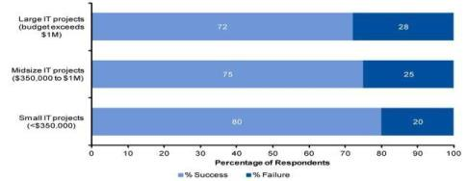
Why do Microservices?
Reduce complexity, increase success
According to a Gartner survey of 150 participants in 2011, the failure of projects exceeding $1 million was found to be almost 50% higher than for projects with budgets below $350,000.
This result was reinforced by prior Gartner IT projects which found small IT projects to experience a one-third lower failure rate than large projects
https://thisiswhatgoodlookslike.com/2012/06/10/gartner-survey-shows-why-projects-fail/

Slide 58
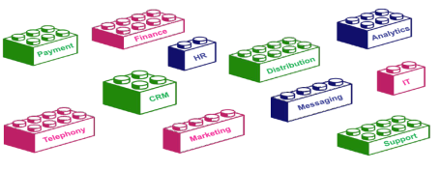
Microservice building blocks
APIs provide the flexibility for businesses to grow by adopting new business models and enable accelerated development of new applications.
It is like picking different LEGO blocks to build a toy house.
Notes:
As we make engineering decisions, we need to constantly consider impacts regarding:
Team Skills
Process & Measurements
Architecture & Engineering

Slide 59
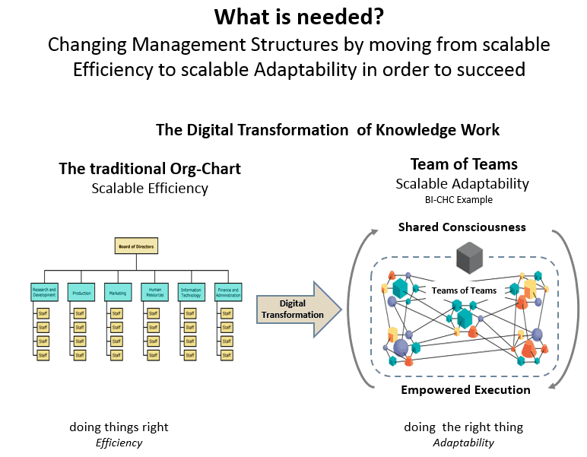
Resolution: Service Oriented Architecture
This concept aligns with General Stanley McChrystal’s recent work Team of Teams.
As McChrystal writes: “To defeat a network, we had to become a network.“
A network in this context is a collection of small cross-functional teams that have been empowered to self-organize, self-manage, and self-execute.
Teams are enabled to become a ‘network’ by a Service Oriented Architecture (SOA) and have done so at various adopted of SOA such as AWS, Netflix et tal
Cost, time to market, and adaptiveness are vastly improved
Notes:
https://www.scruminc.com/complexity-changes-leadership/

Slide 60
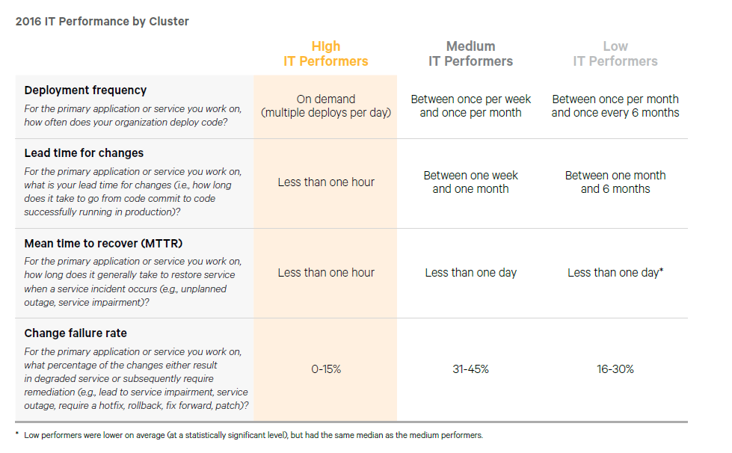
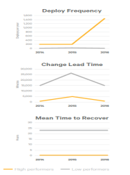
External Benchmarks
Competitive Advantage
High performing teams are breaking away from the pack and the status quo of even three years ago is a dangerous assumption currently.
A team which had state of the art development practices as recently as 3 years ago can find themselves outpaced by competition today.
* Source: Puppet Labs Report
Notes:
The third annual DevOps survey by Puppet Labs, IT Revolution Press and ThoughtWorks garnered more than 9,200 responses from technical professionals around the world
Companies with high-performing IT organizations are twice as likely to exceed their profitability, market share and productivity goals.
The individual measures that make up IT performance are deployment frequency, lead time for changes, and mean time to recover from failure
https://puppet.com/resources/white-paper/2014-state-of-devops-report/thank-you

Slide 61
Microservices Patterns
Before diving into Microservices Patterns, let’s walk through a Sample Monolithic Application.
Later we will convert the same application to Microservices and deploy in Kubernetes

Slide 62

Writing Monolithic - Java
CLASSROOM WORK 101 (45 minutes)
Maven Build and Run application
Redis data store
Jersey Rest API
Docker compose
https://github.com/shekhar2010us/microservices_monolithic_docker
Notes:
https://github.com/shekhar2010us/restful-test

Slide 63
Sample Monolithic App in Java
Get user details
Get product details
User
Product
User id
User name
User credit
Product id
Product name
Product price
User buys a product
Only if his credit >= product price

Slide 64
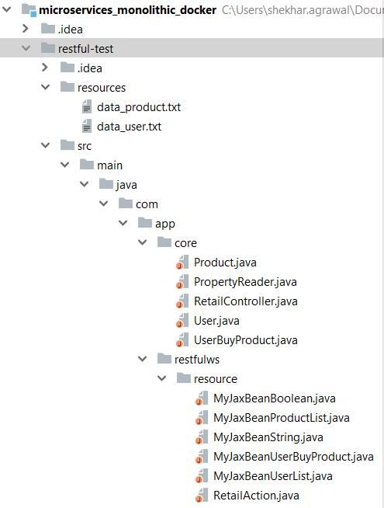
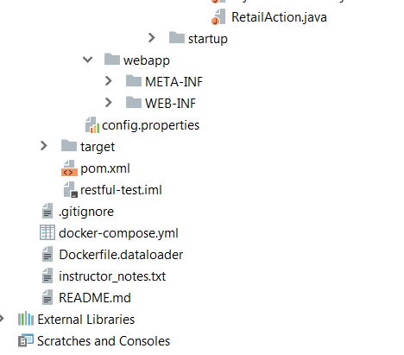
Project Structure
Static data to
load to redis
web.xml
controller,
POJO
Docker files
Jersey Rest
https://github.com/shekhar2010us/microservices_monolithic_docker/blob/master/README.md

Slide 65
Setup – Running Java Monolithic
Login to virtual machine
Install docker, maven and git
Pull code
Build code
Build docker image
Run docker-compose
https://github.com/shekhar2010us/microservices_monolithic_docker/blob/master/setup_notes.md

Slide 66
Patterns

Slide 67

What is a pattern?
Reusable solution to a problem occurring in a particular context
Notes:
slideshare.net/chris.e.richardson/microservices-pattern-language-microxchg-microxchg2016

Slide 68
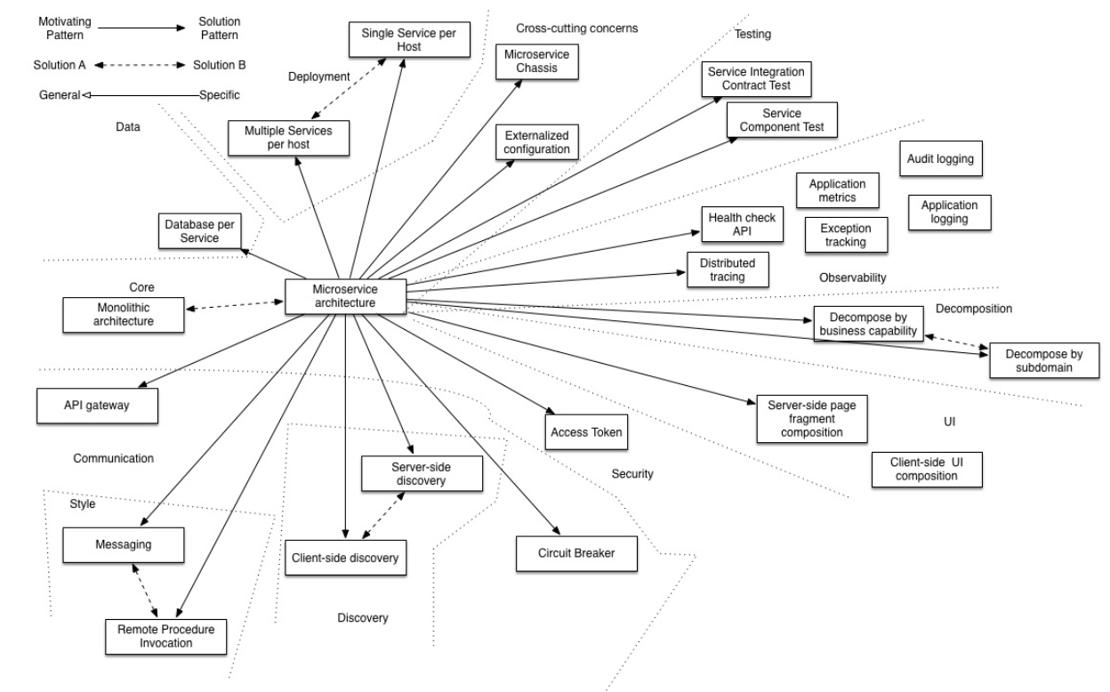
Microservice Architectures
Notes:
Reference: http://microservices.io/patterns/index.html

Slide 69
Pattern - Categories
Data Management
Communication
Deployment
Discovery
Reliability
Observability
Testing
Notes:
Private tables per service may be a middle ground between the two approaches, but care must be taken to enforce access controls.
Further Reading:
http://microservices.io/patterns/data/database-per-service.html
http://microservices.io/patterns/data/shared-database.html

Slide 70
Data Management Patterns
Shared database
Database per Service
Saga
Event Sourcing
CQRS (Command Query Responsibility Segregation)
API Composition
Notes:
Private tables per service may be a middle ground between the two approaches, but care must be taken to enforce access controls.
Further Reading:
http://microservices.io/patterns/data/database-per-service.html
http://microservices.io/patterns/data/shared-database.html

Slide 71
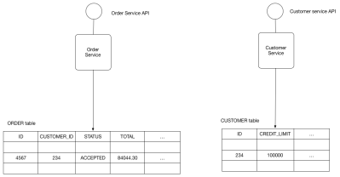
Shared Database
Shared Database
Use a (single) database shared by multiple services. Local ACID transactions.
Benefits:
Straightforward ACID transactions to enforce data consistency
Single database is simpler to operate
Drawbacks:
Since all services access the same database, interference and transaction locks on the table.
Single database might not satisfy the data storage and requirements of all services.
Notes:
Private tables per service may be a middle ground between the two approaches, but care must be taken to enforce access controls.
Further Reading:
http://microservices.io/patterns/data/database-per-service.html
http://microservices.io/patterns/data/shared-database.html

Slide 72
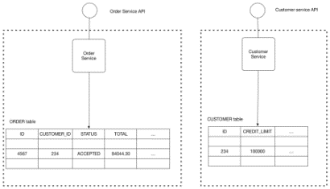
Database Per Service
Database Per Service
Every Microservice has its own persistent data and accessible only via its API
E.g. Private-tables-per-service; Schema-per-service; Database-server-per-service
Benefits:
Ensures loose coupling
Each service can use the type of database that is best suited to its needs. E.g., text searches could use ElasticSearch; social graph could use Neo4j.
Drawbacks:
Transactions involving multiple services not straight forward
For consistency; may need to implement capability to roll back (Saga pattern)
Interaction is achieved by message/event brokers
Notes:
Private tables per service may be a middle ground between the two approaches, but care must be taken to enforce access controls.
Further Reading:
http://microservices.io/patterns/data/database-per-service.html
http://microservices.io/patterns/data/shared-database.html

Slide 73
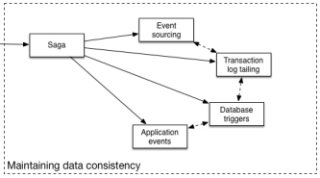
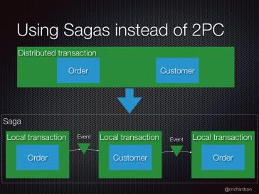
Saga Pattern – For Data Consistency
Saga Pattern
Grouping transactions with the capability to undo changes if the transaction fails
enables an application to maintain data consistency across multiple services
How to reliably/atomically publish
events whenever state changes?
Solution can be Event Sourcing
Notes:
Further Reading:
http://microservices.io/patterns/data/saga.html
http://microservices.io/patterns/data/api-composition.html

Slide 74
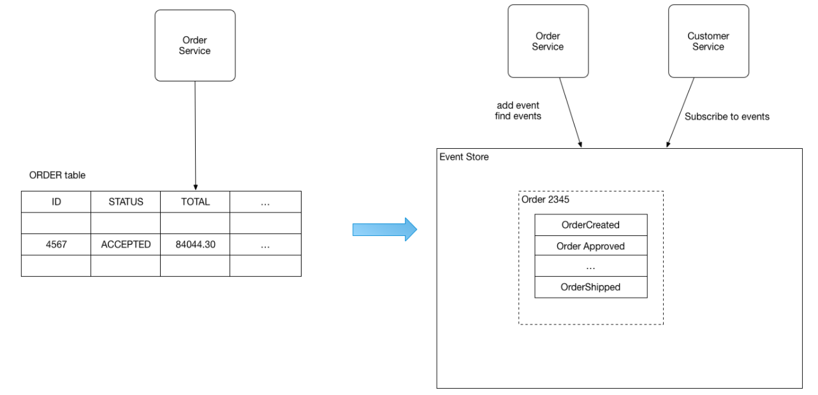
Event Sourcing
Persists the state of a business entity as a sequence of state-changing events – in Event Store
The store has APIs for adding, retrieving an entity’s events and subscribe to events.
The store is like a message broker; A new event is delivered to all interested subscribers.
E.g. the Order is saved as sequence of events, and customerService subscribe to those events
Benefits:
reliably publish events whenever state changes
Drawbacks:
Difficult to design (unconventional)
The event store is difficult to query since it requires typical queries to reconstruct the state of the business entities - complex and inefficient --- use CQRS to query
Notes:
Further Reading:
http://microservices.io/patterns/data/saga.html
http://microservices.io/patterns/data/api-composition.html

Slide 75
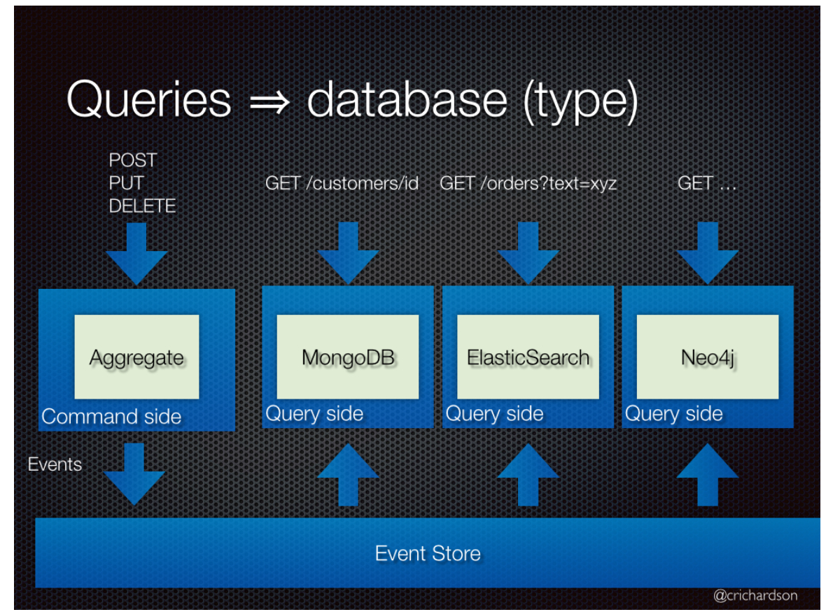
CQRS – Command Query Responsibility Segregation
Split the application into two parts:
Command-side: handles create, update, and delete requests and emits events when data changes.
Query-side: handles queries by executing them against one or more materialized views that are kept up to date by subscribing to the stream of events emitted when data changes.
A Command cannot return data and
a Query cannot change the data.
Use Case
Get data from multiple different Aggregates
Application has an imbalance in responsibility (read/writes)
How to
Two models talking to same date store (applications that require synchronous processing and immediate results.)
Two models talking to different data store (Eventual Consistency)
Notes:
Further Reading:
http://microservices.io/patterns/data/saga.html
http://microservices.io/patterns/data/api-composition.html

Slide 76
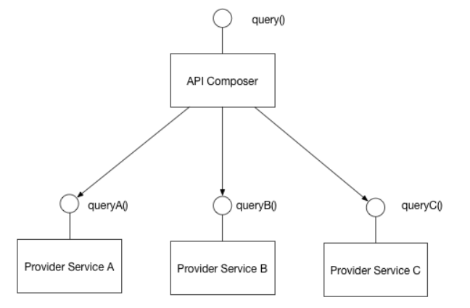
API Composition
Perform queries in Microservices architecture
Implement a query by defining an API Composer, which invoking the services that own the data and performs an in-memory join of the results.
Benefits:
It a simple way to query data in a Microservice architecture
Drawbacks:
Some queries would result in inefficient, in-memory joins of large datasets.
Notes:
Further Reading:
http://microservices.io/patterns/data/saga.html
http://microservices.io/patterns/data/api-composition.html

Slide 77
Pattern - Categories
Data Management
Communication
Deployment
Discovery
Reliability
Observability
Testing

Slide 78



Communication Style
Messaging
Services communicate by sending asynchronous messages
Decouples client & service
Must also install and maintain a broker (Kafka, RabbitMQ, etc)
Complex and should be highly available
Remote Procedure Invocation
Simple and familiar
Both client and service must be available
Only simple request and reply. Notifications, publish/subscribe, async communication not supported
E.g. Rest, Thrift
Notes:
Domain specific protocol
Email such as SMTP or IMAP
Media streaming such as RTMP, HLS, etc
Further Reading:
http://microservices.io/patterns/communication-style/rpi.html
http://microservices.io/patterns/communication-style/messaging.html
http://microservices.io/patterns/communication-style/domain-specific.html

Slide 79
Pattern - Categories
Data Management
Communication
Deployment
Discovery
Reliability
Observability
Testing

Slide 80
Deployment Patterns
Service instance per host
Multiple Service instance per host
Service instance per VM
Service instance per container
Server-less

Slide 81
Service instance per host
Deploy each single service instance on its own host
Benefits:
Services instances are isolated from one another
There is no possibility of conflicting resource requirements or dependency versions
A service instance can only consume at most the resources of a single host
It is straightforward to monitor, manage, and redeploy each service instance
Drawbacks:
Potentially less efficient resource utilization
Notes:
Further Reading:
http://microservices.io/patterns/deployment/service-per-container.html
http://microservices.io/patterns/deployment/serverless-deployment.html
http://microservices.io/patterns/deployment/service-per-vm.html

Slide 82
Multiple Service instance per host
Run multiple instances of different services on a host (Physical or Virtual machine).
Deploy each service instance as a JVM process. For example, a Tomcat or Jetty instances per service instance.
Deploy multiple service instances in the same JVM. For example, as web applications or OSGI bundles.
Benefits:
More efficient resource utilization
Drawbacks:
Risk of conflicting resource requirements
Risk of conflicting dependency versions
Difficult to limit the resources consumed by a service instance
If multiple services instances are deployed in the same process then its difficult to monitor the resource consumption of each service instance. Its also impossible to isolate each instance
Notes:
Further Reading:
http://microservices.io/patterns/deployment/service-per-container.html
http://microservices.io/patterns/deployment/serverless-deployment.html
http://microservices.io/patterns/deployment/service-per-vm.html

Slide 83
Service instance per VM
Package the service as a virtual machine image and deploy each service instance as a separate VM
Benefits:
Straightforward to scale the service by increasing the number of instances. Amazon Autoscaling Groups can even do this automatically based on load.
The VM encapsulates the details of the technology used to build the service. All services are, for example, started and stopped in exactly the same way.
Each service instance is isolated
A VM imposes limits on the CPU and memory consumed by a service instance
Drawbacks:
Building a VM image is slow and time consuming
Notes:
Further Reading:
http://microservices.io/patterns/deployment/service-per-container.html
http://microservices.io/patterns/deployment/serverless-deployment.html
http://microservices.io/patterns/deployment/service-per-vm.html

Slide 84
Service instance per Container
Package the service as a (Docker) container image and deploy each service instance as a container
E.g. Kubernetes, DC/OS, Marathon/Mesos, Docker Swarm
Benefits:
Easy to scale up and down a service by changing the number of container instances.
The container encapsulates the details of the technology used to build the service.
Each service instance is isolated
A container imposes limits on the CPU and memory consumed by a service instance
Containers are extremely fast to build and start. E.g. 100x faster to package an application as a Docker container than it is to package it as an AMI.
Drawbacks:
Less mature than VMs
Notes:
Further Reading:
http://microservices.io/patterns/deployment/service-per-container.html
http://microservices.io/patterns/deployment/serverless-deployment.html
http://microservices.io/patterns/deployment/service-per-vm.html

Slide 85
Server-less
Deployment infrastructure hides the concept of servers and takes the service’s code & desired performance characteristics and runs the service.
The deployment infrastructure is a utility operated by a public cloud provider. It typically uses either containers or virtual machines to isolate the services.
E.g. AWS Lambda, Google Cloud Functions, Azure functions
Benefits:
Eliminates the need to spend time on the heavy lifting of managing low-level infrastructure.
Extremely elastic. It automatically scales your services to handle the load.
You pay for each request rather than provisioning what might be under utilized VMs or containers.
Drawbacks:
Has far more constraints than a VM/Container-based infrastructure. E.g., language support.
Only suitable for deploying stateless applications, not for long running stateful or message broker.
Risk of high latency - the time it takes for the infrastructure to provision an instance and for the function to initialize might result in significant latency.
Can only react to increases in load, cannot proactively pre-provision capacity.
Notes:
Further Reading:
http://microservices.io/patterns/deployment/service-per-container.html
http://microservices.io/patterns/deployment/serverless-deployment.html
http://microservices.io/patterns/deployment/service-per-vm.html

Slide 86
Pattern - Categories
Data Management
Communication
Deployment
Discovery
Reliability
Observability
Testing

Slide 87

Service Discovery
Service instances have dynamically assigned network locations. Moreover, the set of service instances changes dynamically because of autoscaling, failures, and upgrades. Consequently, the client code needs to use a more elaborate service discovery mechanism.
Notes:
https://www.nginx.com/blog/service-discovery-in-a-microservices-architecture/
Discovery is one of the first issues encountered when implementing microservices. One of Kubernetes initial innovations was a DNS method for services to communicate with one another. Nearly every modern microservice platform has its own service discovery method that is a variant of one discussed here.
Fewer moving parts than Server side service discovery, but couples the client to the Service Registry.
Further Reading:
http://microservices.io/patterns/client-side-discovery.html

Slide 88
Service Registry
Key of service discovery
Database containing the network locations of service instances.
Needs to be highly available and up to date.
Clients can cache network locations obtained from the service registry -- that information eventually becomes out of date
A service registry consists of a cluster of servers that use a replication protocol to maintain consistency.
E.g. Netflix Eureka, consul, Zookeeper
https://github.com/hashicorp/consul-template -- dynamically reconfigure NGINX nginx.conf
Notes:
https://www.nginx.com/blog/service-discovery-in-a-microservices-architecture/

Slide 89

Client-side Service Discovery Pattern
The client queries a service registry, which is a database of available service instances. The client then uses a load‑balancing algorithm to select one of the available service instances and makes a request.
E.g. Netflix OSS
Notes:
https://www.nginx.com/blog/service-discovery-in-a-microservices-architecture/

Slide 90

Server-side Service Discovery Pattern
The client makes a request to a service via a load balancer. The load balancer queries the service registry and routes each request to an available service instance. As with client‑side discovery, service instances are registered and deregistered with the service registry.
E.g. Kubernetes, Mesos, AWS Elastic LoadBalancer
Notes:
https://www.nginx.com/blog/service-discovery-in-a-microservices-architecture/

Slide 91


API Gateway
Single entry point for all clients. The API gateway handles requests in one of two ways:
Proxied/routed to the appropriate service
Fanned out to multiple service
The API gateway can expose a different API for each client.
E.g., Netflix API gateway runs client-specific adapter code
Benefits:
Insulates the clients from how the application is partitioned into microservices
Insulates the clients from the problem of determining the locations of service instances
Provides the optimal API for each client
Drawbacks:
Increased complexity - another moving part to develop, deployed and managed
Increased response time due to the additional network hop through the API gateway.
E.g. Netty
Notes:
Reference: http://microservices.io/patterns/apigateway.html

Slide 92
Pattern - Categories
Data Management
Communication
Deployment
Discovery
Reliability
Observability
Testing

Slide 93

Circuit Breaker
Reason:
Remote calls can fail, reach timeout due to unresponsive supplier.
Increased number of calls may lead to cascading failures across multiple systems
What is it:
Wrap a protected function call in a circuit breaker object, which monitors for failures. Once the failures reach a certain threshold, the circuit breaker trips, and all further calls to the circuit breaker return with an error, without the protected call being made at all.
Notes:
https://martinfowler.com/bliki/CircuitBreaker.html

Slide 94
Pattern - Categories
Data Management
Communication
Deployment
Discovery
Reliability
Observability
Testing

Slide 95
Observability Patterns
Application Metrics
Health check API
Distributed Tracing
Exception Tracking
Log aggregation
Audit Logging

Slide 96

Observability (Metrics)
Health Check API
A health check client - a monitoring service - periodically invokes the endpoint to check the health of the service instance
Ideally, you have a service that can ensure your service is active and accepting requests, a ’Health Check’
Health check examples included Consul, Kubernetes, and various libraries such as Sprint Boot, Gokit, etc.
Application Metrics
Need to understand the behavior of an application so performance and other problems can be proactively managed
Typically come in two models:
Push – service pushes metrics (typically an agent) from the service
Pull – Service pulls metrics from the service (typically a dashboard)
Examples include Prometheus, AWS Cloud Watch, Sysdig, etc
Notes:
http://microservices.io/patterns/observability/application-logging.html
http://microservices.io/patterns/observability/application-metrics.html

Slide 97
Observability Metrics
USE method (Brendan Gregg)
For every resource, check
Utilization: average time that the resource was busy servicing work
Example: One disk is running at 90%
Saturation: the degree to which the resource has extra work which it can’t service, often queued
Example: The CPUs have an average run queue length of four
Error count (rate): the count of error events
Example: This network interface has had fifty late collisions
Useful for resources such as queues, CPU’s, memory, interconnects, etc.
Notes:
http://www.brendangregg.com/usemethod.html

Slide 98

Notes:
http://www.brendangregg.com/linuxperf.html

Slide 99
Observability Metrics
RED method (Tom Wilkie)
For every service, check that
Request count (rate)
Error count (rate)
Duration
Note:
Observability = Logging + Monitoring + Tracing + Visualization
All good instrumentation libraries (Prometheus, Graphite, etc.) have at least three main primitives
Counter: records events that happen such as incoming requests, bad requests, errors, etc.
Gauge: records things that fluctuate over time such as the size of a thread pool
Histogram: records observations of scalar quantities of events such as request durations
Notes:
http://www.brendangregg.com/usemethod.html

Slide 100

Observability (Tracing)
Distributed Tracing
It becomes quite important to understand what broke and why
Common Distributed Tracing functionality
Assign each external request a unique ID
Pass ID to all services involved with handling the request
Include id in all log messages
Record information (start/end time) about requests and operations performed
Notes:
http://microservices.io/patterns/observability/distributed-tracing.html

Slide 101

Observability (Exceptions and Logging)
Exception Tracking
It is crucial to save errors and the corresponding stack trace
Ideally, exceptions are de-duplicated and recorded for further aggregation and investigation
Log deployments and changes
Track changes as they are opportunities for failure
For example, tracking deployments and changes so they can be easily correlated with issues later for faster resolution
*Etsy graphing error rates against new code deployments
Notes:
http://microservices.io/patterns/observability/exception-tracking.html
https://codeascraft.com/2010/12/08/track-every-release/

Slide 102
Observability (Aggregation and Audit)
Log Aggregation
Requests span multiple instances over multiple machines. It is important to gather information in a standardized format
Log files contain errors, warnings, and debug information
It is important to aggregate, search and analyze such logs
Popular solutions for this include the ELK stack (Elastic Search, Logstash and Kibana) and AWS Cloud Watch
Audit Logging
It is vital to know actions a user has performed.
For security and compliance, this is often a must have
Average time to detect intrusions is 98 days for financial services, 197 days for retail, it should/can be much lower
Notes:
Days to intrusion: http://www.zdnet.com/article/businesses-take-over-six-months-to-detect-data-breaches/
http://microservices.io/patterns/observability/audit-logging.html
http://microservices.io/patterns/observability/application-logging.html

Slide 103
Logging best practices
Log output as a set of JSON key/value pairs instead of pure text
Easier for computer to test and aggregate
Easier to make rules and query
Comprehensive
Do this:
“Timestamp: 2017-09-01 1:25”, ”caller”:”main.go:5”, “transport”:”HTTP”,”addr”:”8080”
Not this
“2017-09-01 1:25 main.go 5 HTTP 8080”

Slide 104
Pattern - Categories
Data Management
Communication
Deployment
Discovery
Observability
Testing

Slide 105

Service Integration/Component Testing
Service Integration Contract Tests
End-to-end testing is slow and expensive
Test the APIs (functionality) provided by services
Black box testing
Service Component Tests
Test the components of the service
A test suite that tests a service in isolation using test doubles for any services that it invokes.
White box testing

Slide 106
End-To-End tests Vs Unit Test
End-to-end tests: time taking and expensive
The dev team might have to spend weeks finding all the issues breaking the end-to-end test
They would be better served with a large base of unit test that find bugs quickly
Slow
No isolated failures
Simulates a real user
Unit Tests: Fast and cheap
Unit tests should form the majority of tests as they quickly identify bugs and represent a fast feedback loop
When a Unit test fails, the function and area that fails is much narrower in scope than broad end-to-end tests
Fast
Isolated Failures
But do not simulates a real user
Notes:
Reference: https://testing.googleblog.com/2015/04/just-say-no-to-more-end-to-end-tests.html
Analysis
Despite numerous problems, the tests ultimately did catch real bugs. What Went Well
Customer-impacting bugs were identified and fixed before they reached the customer.
What Went Wrong
The team completed their coding milestone a week late (and worked a lot of overtime).
Finding the root cause for a failing end-to-end test is painful and can take a long time.
Partner failures and lab failures ruined the test results on multiple days.
Many smaller bugs were hidden behind bigger bugs.
End-to-end tests were flaky at times.
Developers had to wait until the following day to know if a fix worked or not.

Slide 107
Testing Pyramid
Google recommends a 70/20/10 test composition split
70% unit tests
20% integration tests
10% end-to-end tests
End-to-End
Integration
Unit

Slide 108

Technical Debt Payback
Addressing Technical Debt makes an assumption that the team will get a payoff on their investment
Have more unit tests, helps in continuous deployment, helps in fast tracing of errors and building a resilient product – This reduces technical debt
The interest from technical debt can be used to reduce even more technical debt (compounding)
Notes:
https://martinfowler.com/bliki/DesignStaminaHypothesis.html
https://martinfowler.com/bliki/TechnicalDebt.html
https://www.safaribooksonline.com/library/view/Managing+Software+Debt:+Building+for+Inevitable+Change/9780321700582/footnote.html#ftn.ch02fn3

Slide 109


Static Code Metrics
Coding Techniques to Improve Architecture Agility
Code Complexity – recommend about 20 lines per method
Cyclomatic Complexity (# of linearly independent paths) – recommend keep it low
Coupling (measure of how many classes a single class uses), keep it low
Inheritance, no deeper than 6.
Cyclomatic Complexity
Class coupling example
Notes:
Cyclomatic Complexity
Describes the number of paths that go through your code and correlates to the number of unit tests you have to write
Soft recommendation of 1-5. Values 6-10 warrants investigation and 10+ are strong candidates for refactoring
Consider these topics: NPS, Defects, Risk GAP, Supply chain, how brittle, cycle time, uptime. Teams that never address these will have more brittle, harder to update products.
Reference: DevOps on the Microsoft Stack
by Wouter de Kort
Publisher: Apress
Release Date: May 2016
https://www.safaribooksonline.com/library/view/devops-on-the/9781484214466/A346706_1_En_8_Chapter.html

Slide 110
EXTERNAL BENCHMARKS (Velocity & Stability Metrics)
Competitive Advantage
High performing teams are breaking away from the pack and the status quo of even three years ago is a dangerous assumption currently.
A team which had state of the art development practices as recently as 3 years ago can find themselves outpaced by competition today.
* Source: Puppet Labs Report
Notes:
The third annual DevOps survey by Puppet Labs, IT Revolution Press and ThoughtWorks garnered more than 9,200 responses from technical professionals around the world
Companies with high-performing IT organizations are twice as likely to exceed their profitability, market share and productivity goals.
The individual measures that make up IT performance are deployment frequency, lead time for changes, and mean time to recover from failure
https://puppet.com/resources/white-paper/2014-state-of-devops-report/thank-you

Slide 111
Like Inflation, technical debt can be gauged by a basket of indicators
If a theoretical team spent zero time addressing technical debt, we would expect these thresholds to be crossed
Static Code Metrics
Code Complexity =<20 lines per method
Cyclomatic Complexity =<1-5 paths
Coupling =< 9
Inheritance =< 6
Security Vulnerabilities
Critical =< 0 fix immediately
Med/Low =< fix within 30 days
Open Defects
Average time open <= 30 days
Code Velocity
Lead (Cycle) time <= 6 weeks
Deployments per month >= 2
Code Stability
Uptime >= 99.9 %
Mean Time To Recovery <= 4 hours
Tests
Unit Coverage >= 80%
Notes:
Lines of code
Advise a recommended lines of code per method, approx 20
Single Responsibility Pattern: A class should have only one reason to change. Meaning that a class should have no more than one responsibility.
Open/Closed Principle: Software entities should be open for extension but closed for modification
Liskov Substitution Principle : Derived classes can be used everywhere a base class is expected
Interface Segregation Principle : A client shouldn’t be forced to depend on methods he doesn’t use
Dependency Inversion Principle : Depend upon abstractions, not implementations
Reference: DevOps on the Microsoft Stack
by Wouter de Kort
Publisher: Apress
Release Date: May 2016
https://www.safaribooksonline.com/library/view/devops-on-the/9781484214466/A346706_1_En_8_Chapter.html

Slide 112
Microservices - Definition of Done
Can be deployed, replaced, and upgraded independently (Services are autonomous, loosely coupled)
Published service interface (Services are discoverable)
Bounded Context (Specific responsibility enforced by explicit boundaries)
Externally accessible API
No other forms of communication allowed, no tickets, direct linking, reads of data stores, no back doors, only service interface calls over the network

Slide 113
Microservices in Netflix
By Josh Evans (Director of Operational Engg.)
At Qcon, San Francisco, 2016
https://www.youtube.com/watch?v=CZ3wIuvmHeM
Notes:
One hour long video. I usually let students watch this

Slide 114

Microservices in Netflix

Slide 115

Microservices in Netflix

Slide 116
Microservices in Netflix
ELB
Dependencies
Eventual consistency, CAP
Circuit breakers
Workload partitioning
Auto-scaling
Multi-region failure strategy

Slide 117
Microservices in Couchbase
By Arun Gupta (VP Engg.)
At Devoxx, Belgium, 2015
https://www.youtube.com/watch?v=iJVW7v8O9BU
Notes:
To long to watch in class

Slide 118

Microservices in Couchbase

Slide 119

Microservices in Couchbase

Slide 120

Microservices in Couchbase

Slide 121

Microservices in Couchbase

Slide 122
Microservices in Couchbase
Microservices architecture and Design patterns
An example (in Java EE), for a shopping cart application.
Monolithic → Microservices concept and code
Service Registry: FixedURI, Zookeeper
Event Sourcing, CQRS

Slide 123

Part 2: Microservices in Development
Notes:
Recommended reading:
https://thenewstack.io/microservices-changed-matter/
Excerpt:
“…What works? It starts with the organization and the API: A microservices-based product team and a separate backend-based platform team with an API between them, where the API calls are made and the infrastructure responds consistently and accordingly.
Microservices is defined as a loosely-coupled, service-oriented architecture with bounded context. It allows updates without needing to understand how everything else works. Services are built across organizations, and ownership stays in one place. Microservices architecture serves more as point-to-point calls between systems. You must have flexible message formats; irrespective of the versions, everything still works. That means when building a microservices architecture, you need some tooling to configure, discover, route traffic and observe and build systems.
(continued on next page)

Slide 124
Part 2: Microservices in Development
Notes:
IBM’s Andrew Hately, distinguished engineer and chief technology officer for IBM Cloud Labs, offers the context that fifteen years ago, people might check their bank balance once a week. In time, the Internet allowed people to check their balances, and taking that accessibility further, smartphones drove, perhaps, the most change. Today, people can get instant access to every spend on their accounts. That speed and immediacy means that businesses have to respond with services that are developed on the same scale that the social networks and search companies developed their services on over the past five to ten years.

Slide 125
Optimize for Time to Value
“Today, when organizations measure and optimize their activities, time to value is becoming a dominant metric”
–Adrian Cockcroft, Devops thought leader reknown for architecture work at Netflix and VP of AWS

Slide 126

Overview of Docker Containers
Docker installation as done in Classroom work 101

Slide 127

Containers
Notes:
Traditional Methods of deploying applications
Typically virtualize the hardware layer (i.e. virtual server)
Entangled executable, libraries, configuration and lifecycle with host OS
VMs tend to be heavier, approx 600MB to several GB
Hypervisor layer can take up to 33% of CPU overhead
Container based approaches
Operating system virtualization (i.e. virtual Linux machine)
Encapsulated executables, libraries, configuration, and lifecycle
Containers tend to be lighter, approx. 20MB to several hundred MB.
Container layer can typically take between 2-5% CPU overhead

Slide 128

Container Advantages
Portable
Isolated
Lighter footprint & overhead (vs VMs)
Simplify Devops practices
Speed up Continuous Integration
Empower Microservice architectures and adoption

Slide 129

Challenges with Multiple Containers
How to scale?
Once I scale, where are they?
How do my containers find each other?
How should I manage port conflicts?
What if a host fails?
How to update them? Health checks?
How will I track their logs?

Slide 130
The Need for Container Orchestration
Containers are becoming the standard unit of deployment
Each container image has
Code
Binaries
Configuration
Libraries
Frameworks
Runtime
Developers and Operators love containers
Notes:
Docker is developer centric technology
Immutable artifact for your application – that can easily be replicated and recreated in many different environments and platforms that has a Linux host. In order to share your application across many machines and development environments.
Each container image has all the things listed and have complete portability across machines and environments that contains docker engine

Slide 131
The Need for Container Orchestration
Docker has solved the problem of packaging, deploying and running containerized applications
Docker has 3 key components
Container Engine
Registry
Tools (like docker-cli, docker-compose, docker-machine, etc.)
Docker is great for managing a few containers running on a fewer machines
Production applications deal with dozens of containers running on hundreds of machines
Notes:
Docker is great for running few containers or a collection and is built around abstraction on single machine.
When you move to production – you start dealing with distributed system challenges that require much more sophisticated tooling

Slide 132
The Need for Container Orchestration
The unit of deployment is changing from a machine to a container
Infrastructure has become immutable
Emphasis on treating the datacenter as a large server (cluster)
Tools are evolving to manage the new datacenter infrastructure
Docker Swarm
Kubernetes
Mesosphere DC/OS
Manage the lifecycle of containerized applications running in production
Automate the distribution of applications
Notes:
Idea from google – instead of considering the abstraction of running few containers on a single machine – google thought the entire data center as a server.

Slide 133

Container Orchestration Tools
The three most popular are: Kubernetes, Docker Swam & Mesos
Kubernetes has become the unofficial standard
Notes:
Google started creation of its own open source orchestration tool ‘Kubernetes’. It has slowly gained dominance as the standard container orchestration tool except for niche use cases.
Mesos
Still used in early container adoption shops and big data applications
Docker Swarm
Lightweight and may be useful for rapid prototyping. With the ease of deploying Kubernetes to public cloud and greater feature set of Kubernetes this use case is increasingly shrinking.

Slide 134
Kubernetes Stats
Top 100 project by stars
22k LinkedIn professionals
Largest container management ecosystem
Github
54k+ Commits | 280+ Releases | 1365+ Contributors
Top 100 Forked Github Project | Top 2 Starred Go Project | Top 0.01% Starred Github Project

Slide 135

Feature Comparison (March 2016)
Notes:
This is a rapidly changing patch work. This snapshot is of 03/2016. (https://blog.octo.com/docker-en-production-la-bataille-sanglante-des-orchestrateurs-de-conteneurs/)
Since then Kubernetes has an improved WebUI, Autoscaling and Multi-tenancy features among others. It’s a fast moving space!

Slide 136
Architecture – Bird’s Eye View
Cluster Management / Orchestration Engine
(Provisioning, Config Management, Packaging, OS patches, logging, monitoring)
Cluster 3
Cluster 4
Application
Application
Application
Cluster 1
Cluster 2
Application
Application
Application
vm
vm
vm
vm
vm
vm
vm
vm
Physical Infrastructure
Notes:
Fundamental shift is happening in the way the applications are package and deployed.
Currently one application is dedicated to one VM, and for scaling we spin more VMs. It happens that the application is using just 20-25% of the VM, and that’s why VMs cannot be considered as unit of scale.
Microservices - group of homogeneous containers working together to deliver a meaningful application. In Microservices, we create multiple isolated partition and logical boundaries within group of VMs to form clusters, and clusters are used to run applications.
Now, we have multiple layers to manage --- here’s why we use Kubernetes, This is the face of the cluster and applications are submitted through it, no need to interact with individual machines. It decide the following -- Application scheduling, provisioning, resources are sufficient, spin more VMs.

Slide 137
What is Kubernetes?
Kubernetes is inspired from an internal Google project called Borg
Open source project managed by the Linux Foundation
Unified API for deploying web applications, batch jobs, and databases
Decouples applications from machines through containers
Declarative approach to deploying applications
Automates application configuration through service discovery
Maintains and tracks the global view of the cluster
APIs for deployment workflows
Rolling updates, canary deploys, and blue-green deployments
Notes:
Unified API – Rest API to call various applications.
Decouple – Works on abstraction or logical pool of infrastructure, and apps are not tied directly to machines
Declarative approach – define/declare the entire requirement or specs in JSON or Yaml files and submit to Kubernetes. An example:- I need a stateful application, that use SSD back-end; better I/O; 20 instances to be run anywhere in cluster; expose set of containers following under this group and expose these ports, etc.
Service discovery – Earlier, when apps are hosted in physical drives, the network protocols used to be static. Now, we use containers and we need massive scaling and autoscaling, here network protocols like IP/ports are dynamic, service discovery is used to manage

Slide 138
Kubernetes Architecture
Yaml/Json
config file
Kubernetes Master
API
Node 1
Node 2
UI
Node 3
CLI
Node n
Registry
Notes:
Kubernetes is a distributed system, it has a master that maintains the global view and has access to set of nodes that runs the workloads.
API, UI (has dashboard) or CLI (kubectl) are used to submit the workload or interact with the master. They submit using Yaml or Json (config) file. The role of the master is to understand the definition of Yaml, figure out constraints/policies/requirements, cores/memory requirements, any specific node or type of hardware like ssd, if required, and finally throws the container to schedule the environments. All these are pushed to nodes.
The job of a node is to pull appropriate container images from private/public registry and translates the entire spec into deployment.

Slide 139
Configuring Kubernetes
Minikube (Portable, One VM)
Simplest way to get Kubernetes cluster up and running
Supports Microsoft Windows and Mac OS X
Kubernetes Multi-Node Cluster
Emulates production environment
Good for testing advanced scenarios
Google Container Engine (low-friction, no-touch deployment)
Hosted and managed by Google
Powered by Google Compute Engine
DC/OS with Mesos and Marathon
Hosted and managed by Mesosphere
Notes:
Since a long time now, configuring Kubernetes was painful and requires bit of work, spinning machines and need massive infra. Then version 1.3 rolled out, and with the help of a project called Minikube, it became easy to start a tiny but fully functional Kubernetes single node cluster either on Windows/MacOSx machine.
Github of coreOS

Slide 140
Getting Started with Minikube
Install Oracle VirtualBox for Mac
Install Docker Toolbox for Mac
Install Docker version manager
Install the latest version of Minikube for Mac OS X
Download the latest version of kubectl
Run the following commands from the directory where kubectl is downloaded
chmod +x ./kubectl
sudo mv kubectl /usr/local/bin
Launch minikube
minikube --start –vm-driver=virtualbox
Test minikube installation
minikube status
Kubectl get cs

Slide 141
Local Kubernetes
CLASSROOM WORK (Not Needed)
Minikube is a option for developing locally, but some features are not available and require a cloud provider.
Install Hypervisor (Virtualbox, etc)
Stand up minikube & test
Notes:
Get prerequisites and install from https://github.com/kubernetes/minikube

Slide 142
Google Compute Engine Kubernetes Connect
CLASSROOM WORK (Not Needed)
GCE Kubernetes Quickstart
Sign Up for GC https://cloud.google.com/free/
Install SDK https://cloud.google.com/sdk/
Install kubectl https://github.com/smhillin/intro_to_kubernetes/blob/master/install-gce-client-tools.md
Notes:
https://cloud.google.com/container-engine/docs/quickstart
Once you have gcloud installed, first set a default zone:
$ gcloud config set compute/zone us-west1-a
Then you can create a cluster:
$ gcloud container clusters create kuar-cluster
This will take a few minutes. When the cluster is ready you can get credentials for the cluster using:
$ gcloud auth application-default login
At this point, you should have a cluster configured and ready to go. Unless you would prefer to install Kubernetes elsewhere, you can skip to “The Kubernetes Client”.

Slide 143
AWS Kubernetes Connect
CLASSROOM WORK (Not Needed)
AWS Kubernetes Setup
AWS Does not have a managed K8s service.
Two third party options include Heptio’s quickstart or ’Kops’
Notes:
Heptio Cloud Formation Quickstart:
https://aws.amazon.com/quickstart/architecture/heptio-kubernetes/
Kops Quickstart (requires a domain):
https://kubernetes.io/docs/getting-started-guides/kops/

Slide 144
Azure Kubernetes Connect
CLASSROOM WORK (not needed)
Azure Kubernetes Setup
Login Azure
Download CLI and login with CLI
Powershell may be used for this example, but the CLI will be more versatile and used in future examples
Azure Powershell may be used if limitations are understood: https://docs.microsoft.com/en-us/azure/cloud-shell/limitations
https://docs.microsoft.com/en-us/azure/aks/kubernetes-walkthrough
https://github.com/Azure-Samples/azure-voting-app-redis

Slide 145
Multi-node Kubernetes Installation
CLASSROOM WORK 102 75 minutes (required)
Multi-node Kubernetes Setup in AWS VMs
Install docker and docker-compose
Install kubeadm
Install pod networking; Flannel
Initialize kubelet to create master node
Join other nodes as master or worker
https://github.com/shekhar2010us/microservices_kubernetes_docker/blob/master/kubernetes_setup.md

Slide 146
Kubernetes Installation - Pointers
Swap is disabled on all nodes
SELinux is disabled on all nodes
Firewall is disabled on all nodes
Bridge configuration
Docker 17.06.2 is installed
Storage : Overlay
Cgroup : Systemd
Install crictl
Install pod-network-cidr
Setup private registry
Installation includes:
kubeadm
kubelet
kubectl

Slide 147
HA Kubernetes Installation (high availability)
Creating the HA Kubernetes includes:
Creating reliable constituent nodes that collectively form the HA master implementation
Setting up a redundant, reliable storage layer with clustered etcd
Starting replicated, load balanced Kubernetes API servers
Setting up master-elected Kubernetes scheduler and controller-manager daemons

Slide 148

HA Kubernetes Installation (high availability)

Slide 149

HA Kubernetes Installation (high availability)
Option:
Create a containerized cluster of «etcd»
Keepalived to provide a VIP to the 3 instances of apiserver and nginx as a load balancer

Slide 150

Amazon Case

Slide 151
Amazon Web Services: Situation
In 2002, Amazon was hitting a wall when trying to scale their website to grow with demand.
The system was limited by its databases and a large monolith “big ball of mud” system named Obidos.
In response, Jeff Bezos sent a memo to technical staff which decreed the creation of a service-oriented architecture.

Slide 152
Amazon Web Services: Action
Jeff Bezos 2002, SOA decree
All teams will henceforth expose their data and functionality through service interfaces
Teams must communicate with each other through these interfaces
There will be no other form of inter-process communication allowed: no direct linking, no direct reads of another team’s data store, no shared-memory model, no back-doors whatsoever. The only communication allowed is via service interface calls over the network
It doesn’t matter what technology they use. HTTP, Corba, Pubsub, custom protocols – doesn’t matter
All service interfaces, without exception, must be designed from the ground up to be externalizable. That is to say, the team must plan and design to be able to expose the interface to developers in the outside world. No exceptions
1 Google Platforms Rant https://plus.google.com/+RipRowan/posts/eVeouesvaVX

Slide 153
Amazon Web Services: Action
If a team wanted data or services from another team, they could no longer book their developers into a meeting. They had to query their API’s.
Services are managed by small teams, which act like small independent companies focused on the customers of their service.
“Each of these services require a strong focus on who their customers are, regardless whether they are external or internal” Amazon CTO Werner Vogels
“We can scale our operation independently, maintain unparalleled system availability, and introduce new services quickly without the need for massive reconfiguration.” Amazon CTO Werner Vogels
Notes:
By focusing on scalability and component independence, Amazon has been able to increase their speed of delivery while also improving the safety—in the form of scalability and availability—of their environment.

Slide 154


Complication: Communication is Expensive
Communication grows n^2 with team size
One reason is that according to organizational psychologist Richard Hackman, the number of links between people grows rapidly with team size.
n(n-1)/2 where n is the number of people
Coordination, communication and relating costs lower individual productivity as teams grow
Ideal team size 6 to 8 people. Navy Seals identify 4 as the optimal combat team
Conway’s Law
Organizations which design systems are constrained to produce designs which are copies of the communication structures of these organizations
As groups size increases, the connections increase rapidly
A team of 5 has 10 links
A team of 10 has 45 links to maintain
A small company of 60 people has 1770 links to manage
Data Lake has 91 people which means 4095 links to manage
William Kimball, Professor of Organizational Behavior, explains “The larger a group, the more process problems members encounter carrying out their collective work – social loafing, etc”

Slide 155

Amazon Web Services: Result
Service Oriented Architecture can be observed in Amazon Web Services homepage
Every service listed is an independent ‘2 Pizza Team’ that can plan and develop independently
Additional teams can be readily added due to decentralized layout

Slide 156
Amazon Web Services: Result
By focusing on scalability and service independence, Amazon was able to greatly increase speed of development and scale their development
By having a ‘2-pizza rule’, or team sizes limited to those which can be fed by 2 pizzas (6-10 people), Jeff Bezos asserts that each team will be as productive as possible.
This laid the foundation and DNA for Amazon Web Services, which has occupied > 80% of the market share for cloud hosting and disrupted nearly every incumbent enterprise provider.

Slide 157
Kubernetes Connect
CLASSROOM WORK (15 minutes)
Kubernetes Simple Example
Connect to Kubernetes cluster
Standup app on cluster
Delete app from cluster
https://github.com/kubernetes/kubernetes/blob/master/examples/simple-nginx.md
Notes:
Create a cluster (or reuse a cluster from earlier exercises) and connect to it
Execute the nginx example
https://github.com/kubernetes/kubernetes/blob/master/examples/simple-nginx.md
Some repetition here is intentional. You should be comfortable creating clusters, establishing a connection, verifying its healthy, and then cleaning up resources. This foundation is essential before moving on to advanced concepts

Slide 158
GE Case

Slide 159
GE Oil and Gas: Situation
GE Oil and Gas committed in 2013 to a wide ranging initiative with several goals
Improve productivity of shop floors
Build applications and solutions that reduce downtime and improve operations
Cut costs
Improve speed and agility of IT processes and Infrastructure
45,000 employees
11 different regions
7 research centers
85% of worlds offshore oil rigs use GE drilling systems
$5B annual spend on energy research and development
900 applications (9000 applications in greater GE)
Many Apps have 100 or fewer users

Slide 160

GE Oil and Gas: Action
In order to reduce outages and improve automation, elected to more app portfolio to cloud
While doing so, encountered organizational challenges and had to do things differently in order to achieve their goal
GE achieve massive improvements in productivity by changing fundamentally how they worked

Slide 161

GE Oil and Gas: Action
GE achieved a massive increase in productivity by working differently
They broke down silos and united the team to a single cross functional ownership.
They were able to do this by shrinking the work pieces into smaller deliverables
Finally, the teams delivered more frequent artifacts to users, resulting in ‘Happier’ users

Slide 162

GE Oil and Gas: Result
Adopting Devops best-practices and moving to cloud
GE received a 52% reduction in TCO (total cost)
Bot-enabled automation
Self service
Dynamic storage
VM cost optimization
Migration from Oracle to Amazon Aurora
Big increase in productivity
50% reduction in tickets
98% reduction in impactful business outages and incidents
Notes:
References:
AWS Sydney Australia https://aws.amazon.com/blogs/aws/ge-oil-gas-digital-transformation-in-the-cloud/
GE Oil and Gas Presentation https://www.youtube.com/watch?v=DFGFaJZFtuk
GE, AWS adoption http://www.slideshare.net/AmazonWebServices/ism209-acceleration-of-aws-enterprise-adoption-in-ge

Slide 163


Conway’s Law
“Organizations which design systems … are constrained to produce designs which are copies of the communication structures of these organizations.” –Melvin Conway
Do This
Not that
Notes:
https://martinfowler.com/articles/microservices.html

Slide 164
Kubernetes Terminology - Pods
The smallest unit that can be scheduled to be deployed through K8s is called a pod.
Homogeneous group of containers.
This group of containers would share storage, Linux namespaces, cgroups, IP addresses. These are co-located, hence share resources and are always scheduled together.
Pods are not intended to live long. They are created, destroyed and re-created on demand, based on the state of the server and the service itself.
Notes:
Pods – collection of homogeneous containers. Docker is designed to run 1 process in 1 container. Suppose you want two applications to work in tandem, (e.g. redis + nginx containers), you can stitch the two containers and make them work like one, here redis+nginx = pod. Make pods for containers only where they need to work together. Pods are dynamically scheduled, so it’s not guaranteed that the same pod will be scheduled in same machine, That is why it’s not a good idea to stitch a stateless and a stateful container together.

Slide 165
Kubernetes Terminology - Service
As pods have a short lifetime, there is no guarantee about the IP address they are served on. This could make the communication of microservices hard.
Hence K8s has introduced the concept of a service, which is an abstraction on top of a number of pods, typically requiring to run a proxy on top, for other services to communicate with it via a Virtual IP address.
This is where you can configure load balancing for your numerous pods and expose them via a service.

Slide 166
Kubernetes Terminology – Master Node
The master node is responsible for the management of Kubernetes cluster. This is the entry point of all administrative tasks. The master node is the one taking care of orchestrating the worker nodes, where the actual services are running.
API Server - The API server is the entry points for all the REST commands used to control the cluster.
etcd storage - is a simple, distributed, consistent key-value store. It’s mainly used for shared configuration and service discovery. Example of data stored by Kubernetes in etcd is jobs being scheduled, created and deployed, pod/service details and state, namespaces and replication information, etc.
Scheduler - The scheduler has the information regarding resources available on the members of the cluster, as well as the ones required for the configured service to run and hence is able to decide where to deploy a specific service.
Controller-manager - A controller uses apiserver to watch the shared state of the cluster and makes corrective changes to the current state to change it to the desired one. An example is the Replication-controller which takes care of the number of pods in the system.

Slide 167
Kubernetes Terminology - Others
Nodes
Hosts that run Kubernetes applications
Containers
Units of packaging
Labels
Key-Value pairs for identification
kubelet - gets the configuration of a pod from the apiserver and ensures that the described containers are up and running.
kube-proxy - acts as a network proxy and a load balancer for a service on a single worker node.

Slide 168

General Architecture - Kubernetes
The master is responsible for
Exposing the API interface
Scheduling the deployments
Managing the cluster
Each node runs a container runtime, such as Docker, along with an agent that communicates with the master.
Nodes run additional components for logging, monitoring, service discovery and optional add-ons
Nodes expose compute, networking and storage resources to applications
Notes:
https://thenewstack.io/kubernetes-an-overview/

Slide 169

Kubernetes Master
Components of master:
API Server
Scheduler
Controller
etcd

Slide 170
Kubernetes Master
The API server is the entry points for all the REST commands used to control the cluster. It processes REST requests, validates them, and executes the bound business logic. The result state has to be persisted in the “etcd” component.
Etcd is an open source, distributed key-value database; it acts as a single source of truth (SSOT) for all components of the Kubernetes cluster. Masters query etcd to retrieve various parameters of the state of the nodes, pods and containers. Etcd is considered a metadata service in Kubernetes.
Controller Manager is responsible for most of the collectors that regulate the state of the cluster. In general, a controller can be considered a daemon that runs in nonterminating loop and is responsible for collecting and sending information to the API server. It works toward getting the shared state of cluster and then making changes to bring the current status of the server to the desired state. The key controllers are replication controller, endpoint controller, namespace controller, and service account controller. The controller manager runs different kind of controllers to handle nodes, endpoints, etc.
Scheduler is one of the key components of Kubernetes master. It is responsible for distributing the workload, tracking resource utilization on cluster nodes and selecting the nodes for the workloads to run. In other words, this is the mechanism responsible for allocating pods to available nodes.
Notes:
https://x-team.com/blog/introduction-kubernetes-architecture/

Slide 171

Kubernetes Nodes
Components of a node:
kubelet
Kube-proxy
Docker
Fluentd

Slide 172
Kubernetes Node Components
Kubelet Service on each node is responsible for relaying information to and from the control plane service. It interacts with etcd store to read configuration details and to write values. It communicates with the master component to receive commands and work. The kubelet process then assumes responsibility for maintaining the state of work and the node server. It manages network rules, port forwarding, etc.
Kubernetes Proxy Service is a proxy service which runs on each node and helps in making services available to the external host. It helps in forwarding the request to correct containers and is capable of performing primitive load balancing. It makes sure that the networking environment is predictable and accessible and at the same time it is isolated as well. It manages pods on node, volumes, secrets, creating new containers’ health checkup, etc.

Slide 173

DC/OS integration with Kubernetes
Mesosphere partnered with Google to leverage the extensibility of Kubernetes and build Kubernetes-Mesos. The open source project that integrates with the Kubernetes scheduling API and the Mesos scheduler runtime, as well as provides an executor component that integrates kubelet services and the Mesos executor runtime.

Slide 174

K8s Architecture - detailed

Slide 175
Kubernetes Connect
CLASSROOM WORK
Kubernetes 101 (go through this)
Running NGINX
Standup NGINX
Curl service from Tutum container
Explore within the container
https://github.com/gravitational/workshop/blob/master/k8s101.md
Notes:
https://github.com/gravitational/workshop/blob/master/k8s101.md
Git clone https://github.com/gravitational/workshop.git
Sections:
Running nginx
Pod IPs
Pod Containers
Note: Make sure to substitute the specific names and IPs for the ones visible to you. I.e. my-nginx-3800858182-auusv is the name in the example, but for you the name from ’kubectl get pods’ should be used

Slide 176

Kubernetes (K8’s for short)
Kubernetes is an open-source system for automating deployment, scaling, and management of containerized applications
Roles and Advantages of using K8s:
Mounting storage systems
Distributing secrets
Checking application health
Replicating application instances
Using Horizontal Pod Autoscaling
Naming and discovering
Balancing loads
Rolling updates
Monitoring resources
Accessing and ingesting logs
Debugging applications
Providing authentication and authorization
Source & official site: https://kubernetes.io
Notes:
What does Kubernetes mean? K8s? Pronounced ”Kates”
The name Kubernetes originates from Greek, meaning helmsman or pilot, and is the root of governor and cybernetic. K8s is an abbreviation derived by replacing the 8 letters “ubernete” with “8”

Slide 177

Kubernetes: Clusters
Allows you to deploy containerized applications to a cluster without tying them specifically to individual machines.
Masters
Coordinates the cluster
Schedules applications
Maintains application state
Scales applications
Rolls out updates
Can be duplicated when HA (High Availability) is desired.
Often run as a service by public cloud providers (Azure/Google Kubernetes as a Service)
Nodes
House workers that run the applications
Three node minimum for production clusters

Slide 178

Kubernetes: Deployments
Allows you to deploy a (self-healing) instance of an application.
Self Healing: Continuously monitors and replaces instances if necessary
Provides declarative updates for Pods and ReplicaSets
Updates actual state to desired state at a controlled rate
For example: Current state, 3 instances of Tomcat. Desired state, 5 instances of Tomcat. -> Create 2 more instances of Tomcat
Relay on declarative manifest to determine intent (i.e. yaml/json file most commonly)
Notes:
Deployments (and controllers) are loops that maintain state.

Slide 179

$ kubectl create
Note: This is just creation of the pod. In order to expose it, a service must be created. In order for it to be respawned, a deployment or replication control must be created.
https://kubernetes.io/docs/concepts/workloads/controllers/deployment/#creating-a-deployment
Notes:
Create a simple pod.yaml with the following contents
apiVersion: v1
kind: Pod
metadata:
name: nginx
labels:
name: nginx
spec:
containers:
- name: nginx
image: nginx
ports:
- containerPort: 80
2. Kubectl create –f pod.yaml
3. Kubectl get pods
This highlights an example of Kubernetes deployment creation. As with many Kubernetes objects, deployments are usually created from a file such as a yaml or json. While this could be done via command line it is often impractical to do so.
Further reading:
https://kubernetes.io/docs/concepts/workloads/controllers/deployment/#creating-a-deployment

Slide 180

Kubernetes: Pods
Allows you to create a group of one or more containers and some shared resources for those containers
Pod Resource Types
Networking, as a unique cluster IP address
Container information:
container image version
specific ports
Etc
Atomic unit of Kubernetes
Tied to node which is it scheduled
Always co-located and co-scheduled
Containers in a pod share
IP address and port space
Filesystem
Storage (Volumnes)
Labels
Secrets
Notes:
Additionally, pods can be tagged with a label for recommended scheduling advice

Slide 181


$ kubectl get pods
Note: Logs from pods are readily available with a kubectl logs <podname> command.
Notes:
This highlights an example of listing Kubernetes pods and also getting the logs from said pod.
Logging: more detail –
https://kubernetes.io/docs/concepts/cluster-administration/logging/

Slide 182

Kubernetes: Nodes
Allows Pods to be scheduled. A basic worker physical or virtual machine of Kubernetes.
Must be managed by a master
May host multiple pods
Internal IP Address endpoint
Can be tagged and filtered using labels
Must be running two processes
Kubelet – Kubernetes client process. Communicates with master and schedules pods
Container runtime – Docker, Rocket, etc. Pulls and runs containers from registry

Slide 183
$ kubectl get nodes
Notes:
Kubectl get nodes
As long as you have a working cluster and connection to the cluster this command should work. This is usually one of the first commands you call to ensure the cluster is alive.
http://kubernetesbyexample.com/nodes/

Slide 184
Kubernetes Command Line Tool: kubectl
Most common access point for launching workloads on Kubernetes clusters.
kubectl [command] [TYPE] [NAME] [flags]
Very popular commands
kubectl get - list resources about a target.
kubectl get services
kubectl get pods
kubectl describe - show basic information about a resource
Kubectl describe pods my-pod
kubectl logs - print the logs from a container in a pod. Extremely useful
Kubectl logs my-pod
Also useful:
kubectl exec - execute a command on a container in a pod
Kubectl top – Show metrics for a node
Notes:
Trivia: Some internal Kubernetes engineers pronounce kubectl as ‘kubecuttle.’

Slide 185
Kubernetes Connect
CLASSROOM WORK
Kubernetes 101 (2nd section)
Deployments and Replica sets
Services
Back to Deployments
Notes:
https://github.com/gravitational/workshop/blob/master/k8s101.md
Git clone https://github.com/gravitational/workshop.git
Sections:
Deployments and Replicasets
Services
Back to Deployments

Slide 186

Kubernetes: Service
Abstraction regarding a set of pods which enables load balancing, traffic exposure, load balancing and service discovery.
Abstraction that allows pods to die and replicate in Kubernetes without affecting your application.
Enable loose coupling between different Pods.
Provides a stable virtual IP and port
Services allow Pods to receive traffic.
Each Pod has a unique IP but those IP addresses are not exposed outside the Pod without a service.

Slide 187

$ kubectl get services
Note: A component called ‘kube-proxy’ runs on each node and implements a form of virtual IP for services of type other than ‘ExternalName’
Notes:
kubectl get services --all-namespaces
This reveals the kubernetes services that are usually running as part of the kubernetes system namespace.
http://kubernetesbyexample.com/services/

Slide 188

Kubernetes: Label
Key/Value pairs that can be attached to objects to enable a variety of use cases.
Designate objects for specific environments such as development, test and production
Set versions to objects
Set roles or other arbitrary information to classify objects
Can be added or modified at any time

Slide 189

$ kubectl get pod –l name=<label>
Note: Best mechanism to organize Kubernetes objects
Notes:
kubectl run nginx --image nginx --port 80
kubectl get pods
kubectl label pods nginx-158599303-04h8d new-label=awesome
kubectl get pods -l new-label=else
kubectl get pods -l new-label=awesome
kubectl get pods --show-labels
http://kubernetesbyexample.com/labels/

Slide 190
Converting Monolithic to Microservices - Java
CLASSROOM WORK 103 (75 minutes)
Break the existing monolith into logical multiple pieces
Create a separate service for each piece
Take out data dependency from each other
Build docker image for individual services
Select the Microservice Pattern (here, we used Api-Composer)
Create necessary pod, deployment, service, persistent claim and volume in Kubernetes to deploy all services
https://github.com/shekhar2010us/microservices_kubernetes_docker
Notes:
https://github.com/shekhar2010us/restful-test

Slide 191
Microservice App in Java (Taken from Day 1)
Get and set user details
User Service
User id
User name
User credit
User buying a product
Only if user credit >= product price
redis db1
Api composer Service
Stateless and
async call
No db access
Get and set product details
Product Service
product id
product name
Product price
redis db2

Slide 192
Docker Container/Image Requirements (To run the App)
Redis image
To host data
User-service
image
To run user end-points
Store all image to private registry and setup all kubernetes machines to use that private registry
Redis user
data
loader
image
To load user data
To run product end-points
Productservice
image
Redis product
data
loader
image
To load product data
Apicomposer
service
image
To run api-composer end-points

Slide 193
Kubernetes Requirements (To run the App)
Deployment
Deployment
Redis
Service
User-service
Service (LoadBalancer)
Persistent Claim
Deployment
Redis user
data
loader
Pod
Api-composer
service
Service (LoadBalancer)
Deployment
Persistent Claim
Product-service
Service (LoadBalancer)
Redis product
data
loader
Pod
Persistent Claim

Slide 194

Project Structure – User Service
controller,
POJO
Jersey Rest
web.xml
https://github.com/shekhar2010us/microservices_kubernetes_docker

Slide 195

Project Structure – Product Service
controller,
POJO
Jersey Rest
web.xml
https://github.com/shekhar2010us/microservices_kubernetes_docker

Slide 196

Project Structure – Api Composer Service
controller,
POJO
Jersey Rest
web.xml
https://github.com/shekhar2010us/microservices_kubernetes_docker

Slide 197

Project Structure – Kubernetes and Docker
Api composer service
Kubernetes config files
Product service
User service
Docker files
https://github.com/shekhar2010us/microservices_monolithic_docker/blob/master/README.md

Slide 198
Setup – Running Java Microservices
Break monolith to multiple services
Build individual service
Create required docker images
Push all images to private registry
Create kubernetes deployment, pod, services, rc, and persistent claim
Start all kubernetes entities
https://github.com/shekhar2010us/microservices_kubernetes_docker/blob/master/setup_notes.md

Slide 199
Kubernetes Entities (Redis deployment and service)
apiVersion: extensions/v1beta1 kind: Deployment metadata: name: redis spec: replicas: 1 template: metadata: labels: app: redis spec: containers: - image: redis:alpine name: redis
Redis deployment
apiVersion: v1 kind: Service metadata: name: redis spec: type: ClusterIP ports: - port: 6379 targetPort: 6379 selector: app: redis
ClusterIP can only be
accessed from within
the cluster
Redis Service

Slide 200
Kubernetes Entities (Redis user data loader image and pod)
# docker build -f Dockerfile.userdataloader -t java_mvn_redis_userloader:1.0 . FROM maven RUN mkdir /code ADD . /code WORKDIR /code/user-service CMD ["mvn", "clean", "install", "-U"]
Redis user
data_loader
docker image
apiVersion: v1 kind: Pod metadata: name: redis-user-loader spec: containers: - name: redis-user-loader image: java_mvn_redis_userloader:1.0 command: ["mvn", "exec:java", "-Dexec.mainClass"] args: ["com.app.startup.DataLoader"]
Redis user
data_loader pod
** Similar config files for
Redis product
data_loader pod

Slide 201
Kubernetes Entities (User service persistent claim and volume)
kind: PersistentVolume apiVersion: v1 metadata: name: user-service-war-pv labels: type: local spec: storageClassName: manual capacity: storage: 1Gi accessModes: - ReadWriteOnce hostPath: path: "/root/code/microservices_kubernetes_docker/user-service/target/user-service-1.0.war"
Persistent volume
kind: PersistentVolumeClaim apiVersion: v1 metadata: name: user-service-war-pv-claim spec: storageClassName: manual accessModes: - ReadWriteOnce resources: requests: storage: 1Gi
Persistent claim
** Similar config files for
product and api-composer
services

Slide 202
Kubernetes Entities (User service deployment)
apiVersion: extensions/v1beta1 kind: Deployment metadata: name: userservice spec: replicas: 1 template: metadata: labels: app: userservice spec: containers: - image: tomcat name: userservice ports: - containerPort: 8080 volumeMounts: - mountPath: /usr/local/tomcat/webapps/user-service-1.0.war name: user-service-war volumes: - name: user-service-war persistentVolumeClaim: claimName: user-service-war-pv-claim
User service deployment
Using persistent volume for
war file to deploy in
tomcat server
** Similar config files for
product and api-composer
services

Slide 203
Kubernetes Entities (user-service service)
apiVersion: v1 kind: Service metadata: name: userservice spec: type: LoadBalancer ports: - name: "user-service" port: 8080 targetPort: 8080 nodePort: 31003 selector: app: userservice
User service
Type:- LoadBalancer
(accessed for outside cluster using external IP)
apiVersion: v1 kind: Service metadata: name: userservice spec: type: NodePort ports: - name: "user-service" port: 8080 targetPort: 8080 nodePort: 31001 selector: app: userservice
User service
Type:- NodePort
(accessed for outside cluster using port)
** Similar config files for
product and api-composer
services

Slide 204
Successfully converted a Monolith to Microservices and deployed in Kubernetes

Slide 205
Part 3: Microservices in Production

Slide 206


Kubernetes: Scaling
Changing the number of resources to meet a desired state
Accomplished by adjusting the number of replicas in a deployment
Accommodates both scaling up and scaling down to a minimum of 0
Traffic is automatically sent to newly created instances through the service load balancer
Can be used to enable rolling updates without downtime

Slide 207

$ kubectl scale deployments/<deployment> --replicas=<new num>
Note: Make sure to delete the deployments or replicasets when trying to clear out pods.
Notes:
kubectl run nginx –image nginx –port 80
kubectl get deployments
kubectl scale deployments/nginx –replicas=2
kubectl get deployments
http://kubernetesbyexample.com/labels/

Slide 208




Kubernetes: Rolling Update
Updates the pods in a serial manner will load balancing traffic to available instances
If deployment is exposed publicly, the service will load-balance traffic to only active and available pods
Used to enable zero downtime updates
Allows greater application update frequency
Can also be leveraged to rollback to previous versions

Slide 209

$ kubectl set image <deployment> <new-image>
Note: Rolling updates can also be undone (see next slide)
Notes:
Stand up nginx but with an older version, 1.12.1:
1. kubectl run nginx --image nginx:1.12.1 --port 80
Set image to the newer version (latest). This triggers kubernetes to begin a rolling update:
2. kubectl set image deployments/nginx nginx=nginx:latest
Observe the newer image has been rolled out:
3. kubectl describe deployment nginx

Slide 210

$ kubectl rollout undo <deployment>
Note: Rollbacks can also be also enacted with zero-downtime
kubectl rollout status deployment nginx
kubectl rollout history deployment nginx
kubectl rollout history deployment/nginx --revision=3
kubectl rollout undo deployment/nginx --to-revision <num>
Notes:
Roll back to previous version nginx 1.12.1
4. kubectl rollout undo deployments/nginx
Observe changes
5. kubectl describe deployments/nginx

Slide 211



Kubernetes cheat sheet (CRUD snapshot)
Notes:
Kubectl cheat sheet (collection of useful commands):
https://kubernetes.io/docs/user-guide/kubectl-cheatsheet/

Slide 212

Kubernetes: Volumes
Storage that has an explicit lifetime, the same as the pod that encloses it.
A directory accessible to containers in a pod
Volumes outlive containers that run within a pod
May be passed between pods
Data is preserved across container restarts
Azure Disk & Azure File supported

Slide 213

Kubernetes: Volumes
Note: Volumes are based on a wide assortment of underlying storage provides. Every major public cloud (including Azure) has several options for volume storage
Notes:
1. kubectl create -f https://raw.githubusercontent.com/mhausenblas/kbe/master/specs/volumes/pod.yaml
Shell into the first pod
2. kubectl exec sharevol -c c1 -i -t -- bash
Write data to an ‘xchange’ file
3. mount | grep xchange
4. echo 'some data' > /tmp/xchange/data
Exit out of container
5. exit
Now shell into the 2nd container
6. kubectl exec sharevol -c c2 -i -t – bash
7. mount | grep /tmp/data
8. cat /tmp/data/data
View the whole pod.yaml file here: https://github.com/openshift-evangelists/kbe/blob/master/specs/volumes/pod.yaml
Kubernetes by example Volumes: http://kubernetesbyexample.com/volumes/

Slide 214

Kubernetes: Persistent Volumes
Persistent storage in a cluster
Separate to PersistentVolumeClaim, which is a request for storage.
May be created ahead of time in a static manner for use by a cluster
May be created dynamically from available, unclaimed resources
May be freed and passed from user to user so care should be taken to delete contents when done with use
Critical for Stateful containers

Slide 215
Kubernetes Dashboard (optional)
CLASSROOM WORK
Azure Kubernetes Dashboard
Tunnel to a local version of the kubernetes dashboard
Expose and edit two services within the kubernetes dashboard
Notes:
https://docs.microsoft.com/en-us/azure/aks/kubernetes-dashboard
(old)
Note: This exercise will not work in Azure in-browser cloud terminal
https://docs.microsoft.com/en-us/azure/container-service/kubernetes/container-service-kubernetes-ui

Slide 216

Kubernetes: Secrets
An object that contains a small amount of sensitive data such as a password, token or key.
According to 12-factor configuration comes from the environment
Config is everything that is likely to vary between deployments
Can be used by pods and the underlying Kubelet when pulling images
Secrets belong to a specific Kubernetes Namespace
Secret size cannot exceed 1MB
Notes:
Additional Info:
https://developer.ibm.com/recipes/tutorials/use-kubernetes-secrets-to-make-your-app-portable-across-clouds/

Slide 217

Kubernetes: Secrets
Note: Can be mounted as data volumes or exposed as environment variables
Notes:
http://kubernetesbyexample.com/secrets/
1. echo -n "A19fh68B001j" > ./apikey.txt
2. kubectl create secret generic apikey --from-file=./apikey.txt
3. kubectl describe secrets/apikey
4. kubectl create -f https://raw.githubusercontent.com/mhausenblas/kbe/master/specs/secrets/pod.yaml
5. kubectl exec consumesec -c shell -i -t – bash
6. mount | grep apikey
7. cat /tmp/apikey/apikey.txt

Slide 218
Wordpress on Kubernetes
CLASSROOM WORK
Create persistent volume
Create secret for MySQL password
Launch Wordpress
Notes:
Note: Students using GCP will need to use kubectl instead of minikube
https://kubernetes.io/docs/tutorials/stateful-application/mysql-wordpress-persistent-volume/

Slide 219


Kubernetes: Logging
Aggregate, access and print logs from containers
Logs can be accessed from a currently run container or any number or previously run containers, accessed by container name
Containerized apps write logs to stdout and stderr
Cluster level logging can be performed using several different techniques including node level agents, container sidecars, or even having containers push directly to an application
Node level logging is the most common approach, typically using Elasticsearch.
Notes:
Print Logs
Kubectl logs logme
Stream logs
Kubectl logs –f logme

Slide 220


Kubernetes: Logging
https://github.com/smhillin/microservices_bootcamp/blob/master/labs/create-logging-pod.md
Notes:
Create a loging pod
1. kubectl create -f https://raw.githubusercontent.com/mhausenblas/kbe/master/specs/logging/pod.yaml
Grab the last few lines of logs
2. kubectl logs --tail=5 logme -c gen
Grab a stream of the logs
3. kubectl logs -f --since=10s logme -c gen
Clean up
4. kubectl delete -f https://raw.githubusercontent.com/mhausenblas/kbe/master/specs/logging/pod.yaml
Now launch a container that performs an action and then exits. Give it a minute or so to close out
5. kubectl create -f https://raw.githubusercontent.com/mhausenblas/kbe/master/specs/logging/oneshotpod.yaml
Now output the logs of this container
6. kubectl logs -p oneshot -c gen
Clean up
7. kubectl delete -f https://raw.githubusercontent.com/mhausenblas/kbe/master/specs/logging/oneshotpod.yaml
http://kubernetesbyexample.com/logging/

Slide 221
Create Logging Pod
CLASSROOM WORK
https://github.com/smhillin/microservices_bootcamp/blob/master/labs/create-logging-pod.md

Slide 222

Spotify Case

Slide 223
Elastic Search on K8s
CLASSROOM WORK
Clone the examples repo
Deploy Elasticsearch
Verify functionality
Notes:
git clone https://github.com/kubernetes/examples.git
Follow along here https://github.com/kubernetes/examples/tree/master/staging/elasticsearch
Bonus:
Deploy production ready cluster
https://github.com/pires/kubernetes-elasticsearch-cluster
Bonus #2
Expose Kibana

Slide 224

Kubernetes: Stateful Sets
Functionality of deployments with guarantees about ordering and unique identities per Pod.
Pods in a stateful set are not interchangeable
Each Pod has a persistent identifier
Define desired state object, controller performs updates to desired state
Useful for applications that require persistent storage, unique network identifiers, ordered deployment, deletes or updates.
Notes:
https://kubernetes.io/docs/concepts/workloads/controllers/statefulset/

Slide 225
Kubernetes Stateful Application
CLASSROOM WORK
Stand up and watch stateful mysql instances
Query and verify connectivity
Notes:
https://kubernetes.io/docs/tasks/run-application/run-replicated-stateful-application/
Note: This exercise requires a linux VM to run
Note: Create the files locally instead of from the links if the links are unavailable
Note: “Unable to use a TTY – input is not a terminal or the right kind of file” from in-browser command line tool.

Slide 226
Multi-tenancy
Notes:
https://www.safaribooksonline.com/library/view/building-microservice-systems/9781771375917/video258330.html

Slide 227

Kubernetes: Namespace
Partitions the names of API objects
Resources are segmented within namespaces
Sandbox per developer for example
Pods will route dns to default (own) namespace
api.default.svc.cluster.local
Api.foo…
The same app could run independently in different namespaces

Slide 228

Kubernetes: Namespace
Note: Namespaces create an excellent mechanism to subdivide resources and provide isolation. This enables using a cluster for multiple projects or multiple teams
Notes:
Lab : https://github.com/smhillin/microservices_bootcamp/blob/master/labs/name-spaces.md
Get default namespaces
1. kubectl get ns
Create a ‘test’ namespace
2. kubectl create -f https://raw.githubusercontent.com/mhausenblas/kbe/master/specs/ns/ns.yaml
Recheck namespaces and observe
3. kubectl get ns
Now create a pod in this new namespace
4. kubectl create --namespace=test -f https://raw.githubusercontent.com/mhausenblas/kbe/master/specs/ns/pod.yaml
Check pods in this new namespace
5. kubectl get pods --namespace=test

Slide 229


Kubernetes: Configmap
A set of key-value pairs that serve as configuration data for pods. They solve the problem of how to pass config data such as environment variables to pods.
Config maps are commonly composed of:
Command line arguments
Environment variables
Files in a volume
Config maps function similar to secrets, but values are stored as strings and are more readily readable.
Notes:
http://pwittrock.github.io/docs/user-guide/configmap/
Extra resources:
https://docs.openshift.org/latest/dev_guide/configmaps.html

Slide 230
Kubernetes Configmap
CLASSROOM WORK
Create Configmap
Consume Configmap in environment variables
Set command line using Configmap
Consume Configmap in Volume
Notes:
https://github.com/smhillin/microservices_bootcamp/blob/master/labs/configmap.md
http://pwittrock.github.io/docs/user-guide/configmap/

Slide 231

Kubernetes & Prometheus (Metrics)
CLASSROOM WORK
Stand up Prometheus
Gather and monitor metrics
Notes:
Promotheus is an open source time series monitoring and alerting toolkit (originally written by SoundCloud). It is sponsored by the Cloud Native Computing Foundation and was the second project to be adopted after Kubernetes.
https://prometheus.io/docs/introduction/overview/
Stand up simple Prometheus cluster
1. https://github.com/kelseyhightower/oscon-2017-kubernetes-tutorial/blob/master/labs/06-tutorial-metrics.md
Note: Accessing the prometheus cluster locally with minikube: localhost:9090
Additional info:
https://www.weave.works/blog/monitoring-kubernetes-infrastructure/
https://coreos.com/blog/prometheus-and-kubernetes-up-and-running.html
https://koudingspawn.de/kubernetes-monitoring-prometheus/

Slide 232

Spotify: Situation
Founded in April 2006 and launch in Oct 2008, Spotify was immediately competing with incumbent behemoth Apple music.
In addition to a variety of other streaming services, Spotify also had to content with the entry of Google music in 2011 and even Amazon music in 2017.
How does Spotify survive and win with essentially a commodity service while competing with tech giants that have more capital, bigger budgets and access to talent in a larger variety of geographic locations including silicon valley?
Spotify was founded in Stockholm Sweden.

Slide 233

Spotify: Action
"We have chosen to optimize for speed of delivery," said Spotify's principal engineer, Niklas Gustavsson. "The main reason behind this is that we are in a highly competitive and complicated market and we think that we can win by being faster than our competitors."
Optimize for speed
Separated the developer teams into fully autonomous groups of 7 +- 2 individuals
“By making teams as independent as we can, they won't be blocking each other. Each team can execute on their own.” - Gustavsson
Responsible to design, develop, test, and release into production
Self organizing (Kanban, Scrum, mix)
Notes:
Reference: http://www.computerworlduk.com/it-management/spotify-uses-automation-microservices-gain-speed-advantage-3645974/

Slide 234

Spotify: Action
Instead of centrally mandating solutions such as a type of agile or code editor, each team is allowed the freedom to investigate and choose what will make them most productive.
Autonomy leads to cross pollination of best practices
Guild process (Regular meetings of groups of like minded individuals) also encourages cross pollination of best practices
Once best practices are widely adopted then they become defacto standards
Notes:
Reference: https://highfive.com/blog/how-spotify-built-one-of-the-best-engineering-cultures/

Slide 235

Spotify: Action
Each squad has a well defined mission. “"That might be to make the best search product in the world, or the best music stream quality product in the world. Or it might be things like growing our subscriber base or building APIs for third parties.” Gustavsson
Clear long term mission per squad
Lean startup/MVP and validated learning encouraged
Metrics and A/B testing to verify hypothesis
Rapid releases encouraged
How different squads may own different parts of the user experience
Notes:
Reference: http://www.computerworlduk.com/it-management/spotify-uses-automation-microservices-gain-speed-advantage-3645974/

Slide 236

Spotify: Action Summary (1/2)

Slide 237

Spotify: Action Summary (2/2)

Slide 238

Spotify: Result
Scaled to over 1600 employees
Over $2B in revenue
08/17 Spotify was the most downloaded music App in the United States
Over 140M active users with 60M paying subscribers
Planned IPO in the near future
Notes:
References:
https://en.wikipedia.org/wiki/Spotify
https://dzone.com/articles/modeling-microservices-at-spotify-with-petter-mari
https://www.infoq.com/news/2015/12/microservices-spotify
https://clusterhq.com/2016/03/22/microservices-spotify-petter-mahlen/
http://blog.honeypot.io/2015-11-13-what%27s-it-like-to-work-at-Spotify/
https://qconnewyork.com/ny2017/ny2017/presentation/spotify-lessons-learning-let-go-machines.html
https://www.infoq.com/news/2016/10/no-spotify-model
http://nomad8.com/wp-content/uploads/2014/02/Squads-Chapters-Guilds-in-one-page.graffle.pdf
http://www.full-stackagile.com/2016/02/14/team-organisation-squads-chapters-tribes-and-guilds/

Slide 239

Equifax Case

Slide 240


Situation
Facts
143 million breach victims had their names, social security numbers, birth days, addresses and driver licenses stolen by attackers in May 2017
The site was hacked in mid-May, and attacked continued to access the data until late July 2017 (breach discovered)
The Equifax breach notification page was using a free shared CloudFlare SSL, causing many browsers to think it was a phishing site (not terrible, but not helping)
Signing up for Equifax’s identity theft protection forces uses to accept a terms of service that waive ability to sue Equifax. (Also not helping)
Finally, an employee portal in Argentina had admin/admin as the username/password. (indicates a lax security posture)
Notes:
https://www.cnbc.com/2017/09/08/were-you-affected-by-the-equifax-data-breach-one-click-could-cost-you-your-rights-in-court.html
http://www.bbc.com/news/technology-41257576

Slide 241

Action: Equifax Tech Stack
What was the tech stack?
Apache Struts
IBM WebSphere
Java
Apache Struts was compromised by an announced vulnerability 2 months prior (Apache Struts CVE-2017-5638)
Failure to track and update vulnerabilities is a common OWASP (open web application security) issue (A9)
The personal information of the entire US adult population was within reach of this vulnerable web server
Over reliance on perimeter security is absolutely suspect
Notes:
https://blogs.apache.org/foundation/entry/apache-struts-statement-on-equifax
Could have been older struts vulnerability?
https://arstechnica.com/information-technology/2017/09/massive-equifax-breach-caused-by-failure-to-patch-two-month-old-bug/

Slide 242

Action: How to prevent easy attacks?
Learn the basics! OWASP Top 10 application vulnerabilities
Notes:
https://github.com/coreinfrastructure/best-practices-badge/blob/master/doc/criteria.md#know_secure_design
http://emergentchaos.com/the-security-principles-of-saltzer-and-schroeder
https://www.owasp.org/index.php/OWASP_Top_10/Mapping_to_WHID
A5? The number of things you have to configure in any system is huge
How and why to fix?
Vulnerability remediation
Benefits of different type of scanning
Pen testing
Static code scanning
Infrastructure scanning
Port scanning
(continued on next page)

Slide 243
Action: How to prevent easy attacks?
Learn the basics! OWASP Top 10 application vulnerabilities
Notes:
Touch points between dev and security:
Monitoring
Verifying logs are shipped and effective to monitor
Firewalls
Why
How to make it better
Best practice examples
How to make it work
How to access APIs/Interface
Logging
Average time to detect a breach (180 days)
If you are really bad a security you have probably been breached
2 types
Been breached
Don’t know they have been breached

Slide 244
Action: How to prevent easy attacks?
Learn the basics!
8 secure design principles from Saltzer and Schroeder:
Economy of mechanism: Keep the design simple
Fail-safe defaults: Fail towards denying access
Complete mediation: Check authorization of every access request
Open design: Assume attack knows the system internals
Separation of privilege: require two separate keys or other ways to check authorization (2 factor auth)
Least privilege: Give only necessary rights
Least common mechanisms: Ensure failures stay local
Psychological acceptability: design security mechanism that are easy to use
Notes:
https://github.com/coreinfrastructure/best-practices-badge/blob/master/doc/criteria.md#know_secure_design
http://emergentchaos.com/the-security-principles-of-saltzer-and-schroeder

Slide 245

Action: A layered architecture (Microservices) would have likely defeated this attack
Apache Software Foundation Response
“Establish security layers. It is good software engineering practice to have individually secured layers behind a public-facing presentation layer”
“A breach into the presentation layer should never empower access to significant or even all back-end information resources. ”
Principle of Least Privilege
Implementing rate limiting between services would have been effective
Normal use case for data retrieval required retrieving a single record per session and retrieving the entire database should have set off alarms

Slide 246

Action: Monitoring between layers would have also defeated the attack
Apache Software Foundation
“Establish monitoring for unusual access patterns to your public Web resources ”
Queries could have been monitored looking for suspicious behavior
Many open and commercial tools will look for common attach patterns and alert
A firewall could have been placed between services
Basically, don’t put all of America’s PII behind one compromised web server
And if you do, try to monitor and halt the breach before several months pass
Notes:
App teams and developers can get better monitoring in place and better info to monitor

Slide 247
Result: Security basics for Microservices and beyond
OWASP Top 10
8 Secure Design Principles from Saltzer and Schroeder
Understand and keep updated libraries and frameworks used. Know any known security vulnerabilities. Roll out updates rapidly.
Monitor for intrusions and run scenarios if something you imagine cannot be hacked was indeed exploited, what would happen?
Have a layered security defense when possible
Notes:
https://blogs.apache.org/foundation/entry/apache-struts-statement-on-equifax
https://news.ycombinator.com/item?id=15207575
https://www.carbonblack.com/2017/09/07/lessons-equifax-breach/
https://www.bankinfosecurity.com/equifax-breach-exposed-data-143-million-consumers-a-10275
https://www.databreachtoday.com/apache-struts-2-under-zero-day-attack-update-now-a-9761
https://www.bankinfosecurity.com/equifax-breach-8-takeaways-a-10278
https://investor.equifax.com/news-and-events/news/2017/09-15-2017-224018832
Struts was announced, lots of people were scrambling to update it
Equifax hit by 5638 vulnerability
Speed to respond is critical!
Vendors can monitor libraries and alert when risk is to trigger update.
Update in days and hours
You need a WASP if you cannot update quickly.

Slide 248
Kubernetes: Secrets
An object that contains a small amount of sensitive data such as a password, token or key.
According to 12-factor configuration comes from the environment
Config is everything that is likely to vary between deployments
Can be used by pods and the underlying Kubelet when pulling images
Secrets belong to a specific Kubernetes Namespace
Secret size cannot exceed 1MB
Notes:
Additional Info: https://developer.ibm.com/recipes/tutorials/use-kubernetes-secrets-to-make-your-app-portable-across-clouds/

Slide 249
Kubernetes: Secrets
Note: Can be mounted as data volumes or exposed as environment variables
Notes:
http://kubernetesbyexample.com/secrets/
1. echo -n "A19fh68B001j" > ./apikey.txt
2. kubectl create secret generic apikey --from-file=./apikey.txt
3. kubectl describe secrets/apikey
4. kubectl create -f
https://raw.githubusercontent.com/mhausenblas/kbe/master/specs/secrets/pod.yaml
5. kubectl exec -it consumesec /bin/bash
6. mount | grep apikey
7. cat /tmp/apikey/apikey.txt

Slide 250
Kubernetes Secrets
CLASSROOM WORK - Optional
Create Secret config file and pods
Install and Launch Vault
(Optional) Challenge: Replicate Vault Secrets into Kubernetes
Notes:
Tutorial: https://github.com/kelseyhightower/oscon-2017-kubernetes-tutorial/blob/master/labs/04-tutorial-secrets.md
Optional Challenge: https://github.com/kelseyhightower/oscon-2017-kubernetes-tutorial/blob/master/labs/05-challege-secrets.md

Slide 251
Kubernetes: Configmap
A set of key-value pairs that serve as configuration data for pods. They solve the problem of how to pass config data such as environment variables to pods.
Config maps are commonly composed of:
Command line arguments
Environment variables
Files in a volume
Config maps function similar to secrets, but values are stored as strings and are more readily readable.
Notes:
http://pwittrock.github.io/docs/user-guide/configmap/
Extra resources: https://docs.openshift.org/latest/dev_guide/configmaps.html

Slide 252
Kubernetes Configmap
CLASSROOM WORK
Create Configmap
Consume Configmap in environment variables
Set command line using Configmap
Consume Configmap in Volume
Notes:
http://pwittrock.github.io/docs/user-guide/configmap/
Note: It may be easier to wget the files for the exercise.
wget http://pwittrock.github.io/docs/user-guide/configmap/configmap.yaml
kubectl create -f configmap.yaml
Instead of:
kubectl create -f docs/user-guide/configmap/configmap.yaml

Slide 253
Kubernetes: Volumes
Storage that has an explicit lifetime, the same as the pod that encloses it.
A directory accessible to containers in a pod
Volumes outlive containers that run within a pod
May be passed between pods
Data is preserved across container restarts
Azure Disk & Azure File supported

Slide 254
Kubernetes: Volumes
Note: Volumes are based on a wide assortment of underlying storage provides. Every major public cloud (including Azure) has several options for volume storage
Notes:
kubectl create -f https://raw.githubusercontent.com/mhausenblas/kbe/master/specs/volumes/pod.yaml
Shell into the first pod
2. kubectl exec sharevol -c c1 -i -t -- bash
Write data to an ‘xchange’ file
3. mount | grep xchange
4. echo 'some data' > /tmp/xchange/data
Exit out of container
5. exit
(continued on next page)

Slide 255
Kubernetes: Volumes
Note: Volumes are based on a wide assortment of underlying storage provides. Every major public cloud (including Azure) has several options for volume storage
Notes:
Now shell into the 2nd container
6. kubectl exec sharevol -c c2 -i -t – bash
7. mount | grep /tmp/data
8. cat /tmp/data/data
View the whole pod.yaml file here:
https://github.com/openshift-evangelists/kbe/blob/master/specs/volumes/pod.yaml
Kubernetes by example Volumes
http://kubernetesbyexample.com/volumes/

Slide 256
Kubernetes: Persistent Volumes
Persistent storage in a cluster
Separate to PersistentVolumeClaim, which is a request for storage.
May be created ahead of time in a static manner for use by a cluster
May be created dynamically from available, unclaimed resources
May be freed and passed from user to user so care should be taken to delete contents when done with use
Critical for Stateful containers
See example in the wordpress example :: kind: PersistentVolumeClaim

Slide 257
Kubernetes: Logging
Aggregate, access and print logs from containers
Logs can be accessed from a currently run container or any number or previously run containers, accessed by container name
Containerized apps write logs to stdout and stderr
Cluster level logging can be performed using several different techniques including node level agents, container sidecars, or even having containers push directly to an application
Node level logging is the most common approach, typically using Elasticsearch.

Slide 258
Kubernetes: Logging
Note: An external system can perform the log rotation by calling logrotate, which would result in kubectl logs returning an empty result
Notes:
Create a logging pod
kubectl create -f https://raw.githubusercontent.com/mhausenblas/kbe/master/specs/logging/pod.yaml
Grab the last few lines of logs
2. kubectl logs --tail=5 logme -c gen
Grab a stream of the logs
3. kubectl logs -f --since=10s logme -c gen
Clean up
4. kubectl delete -f https://raw.githubusercontent.com/mhausenblas/kbe/master/specs/logging/pod.yaml
(continued on next page)

Slide 259
Kubernetes: Logging
Note: An external system can perform the log rotation by calling logrotate, which would result in kubectl logs returning an empty result
Notes:
Now launch a container that performs an action and then exits. Give it a minute or so to close out
5. kubectl create -f https://raw.githubusercontent.com/mhausenblas/kbe/master/specs/logging/oneshotpod.yaml
Now output the logs of this container
6. kubectl logs -p oneshot -c gen
Clean up
7. kubectl delete -f https://raw.githubusercontent.com/mhausenblas/kbe/master/specs/logging/oneshotpod.yaml
http://kubernetesbyexample.com/logging/

Slide 260
Kubernetes: Stateful Sets
Functionality of deployments with guarantees about ordering and unique identities per Pod.
Pods in a stateful set are not interchangeable
Each Pod has a persistent identifier
Define desired state object, controller performs updates to desired state
Useful for applications that require persistent storage, unique network identifiers, ordered deployment, deletes or updates.
Notes:
https://kubernetes.io/docs/concepts/workloads/controllers/statefulset/

Slide 261
Kubernetes Stateful Application
CLASSROOM WORK
Stand up and watch stateful mysql instances
Query and verify connectivity
Notes:
https://kubernetes.io/docs/tasks/run-application/run-replicated-stateful-application/
Make : apiVersion → apps/v1beta1 for “statefulset”
Note: This exercise requires a linux VM to run
Note: Create the files locally instead of from the links if the links are unavailable
Note: “Unable to use a TTY – input is not a terminal or the right kind of file” from in-browser command line tool.

Slide 262
Kubernetes: Namespace
Partitions the names of API objects
Resources are segmented within namespaces
Sandbox per developer for example
Pods will route dns to default (own) namespace
api.default.svc.cluster.local
Api.foo…
The same app could run independently in different namespaces

Slide 263
Kubernetes: Namespace
Note: Namespaces create an excellent mechanism to subdivide resources and provide isolation. This enables using a cluster for multiple projects or multiple teams
Notes:
Get default namespaces
1. kubectl get ns
Create a ‘test’ namespace
2. kubectl create -f https://raw.githubusercontent.com/mhausenblas/kbe/master/specs/ns/ns.yaml
Recheck namespaces and observe
3. kubectl get ns
Now create a pod in this new namespace
4. kubectl create --namespace=test -f https://raw.githubusercontent.com/mhausenblas/kbe/master/specs/ns/pod.yaml
Check pods in this new namespace
5. kubectl get pods --namespace=test

Slide 264
Security

Slide 265

Secure Traffic
Secure traffic between Microservices
HTTPS
Reconfigure ELBs (on AWS)
Add certificate (letsencrypt.org)
Secure traffic for users
HTTPS
Secure Identity with SPIFFEE & Istio
Notes:
SPIFFE is an early effort to provide automation around certificates, identity and inter microservice communication
https://github.com/spiffe/spire
Istio is a platform desired to connect, manage, and secure microservices
https://istio.io/

Slide 266

Security - Microsegmentation
Segment the network
Only allow white-listed traffic between pods
Common tools
Istio
Calico
Weave
OpenContrail

Slide 267
Security Actions
Ensure attacker who gains access to web container can’t get into the database
Create separate DB users for each Microservice
Strong passwords
K8’s secrets and/or Vault
Only accessed by containers who need them

Slide 268

Security – Least Privilege
“Each subject in a system be granted the most restrictive set of privileges”
Disable public IP access for any machine that doesn’t need it
VPN only for admin access

Slide 269
Security Actions
Limit admin access
“Attribute based access control” mode by default
Access control by token
Can allow/deny API operations
Can be used to only allow certain actions
Webhook (optional)
Add url for k8s to verify authorization

Slide 270
Part 4: Course Summary and Supplemental Lab work

Slide 271
Deploy Cassandra with Stateful Sets
CLASSROOM WORK
Create Cassandra Headless Service
Create a Cassandra Ring
Validate the Stateful Set
Modify the Stateful Set
Notes:
Reference: https://kubernetes.io/docs/tutorials/stateful-application/cassandra/

Slide 272
Helm (package manager) on Kubernetes
CLASSROOM WORK
Verify Helm is working
Install nginx-ingress
Notes:
https://docs.microsoft.com/en-us/azure/container-service/kubernetes/container-service-kubernetes-helm
We observed a weird version error where the server and client version of helm was mismatched. This was resolved by running:
1. helm reset
2. helm init --update

Slide 273
Windows on Kubernetes
CLASSROOM WORK
Verify Connectivity to Kubernetes cluster (skip steps if reusing previous cluster)
Create windows yaml file (iis.ysml)
Stand up windows machines and verify connectivity

Slide 274

Notes:
http://www.full-stackagile.com/2016/02/14/team-organisation-squads-chapters-tribes-and-guilds/
http://nomad8.com/wp-content/uploads/2014/02/Squads-Chapters-Guilds-in-one-page.graffle.pdf
https://ucvox.files.wordpress.com/2012/11/113617905-scaling-agile-spotify-11.pdf

Slide 275


Slide 276


Slide 277
Go, gRPC and Kubernetes (Optional)
CLASSROOM WORK
Define Simple Services
Comm protocol
Common Divisor Service
Frontend API Service
Build Docker Images
Deploy to K8s cluster
Notes:
Excellent tutorial on Kubernetes from the ground up
Golang is a great language with clear syntax and is good for these simple examples. It has syntax similar to Java and C++ for those more familiar with those languages.
https://outcrawl.com/getting-started-microservices-go-grpc-kubernetes/
https://github.com/tinrab/kubernetes-go-grpc-tutorial

Slide 278

K8s Architecture – Networking view
Notes:
Image: http://www.devoperandi.com/load-balancing-in-kubernetes/

Slide 279

K8s Architecture – Simplified

Slide 280

$ az acm create
Notes:
az acs create --orchestrator-type kubernetes --resource-group myResourceGroup --name myK8sCluster --generate-ssh-keys
This highlights an example of Kubernetes cluster creation (on Azure)
Note: the –generate-ssh-keys flag places a id_rsa in the .ssh directory. This key is needed for kubectl to communicate with the cluster
Most common local development environment for rapid prototyping
Minikube: https://kubernetes.io/docs/getting-started-guides/minikube/
Great comprehensive list of possible options:
https://kubernetes.io/docs/setup/pick-right-solution/
Google Container Engine is probably the most performant, inexpensive solution of the bunch
Azure is useful for its support of Windows and Linux node options
The most straight forward way to delete a cluster on Azure is to remove the resource group that houses the cluster and its attached storage, etc
az group delete --name myResourceGroup --yes --no-wait

Slide 281
Kubernetes Connect (Optional)
CLASSROOM WORK
Kubernetes 101 (3nd section – Optional/Extra Credit)
Connecting services
Great exercise, but requires a private registry either locally or use of cloud registry
Notes:
https://github.com/gravitational/workshop/blob/master/k8s101.md
Git clone https://github.com/gravitational/workshop.git
Sections:
Connecting Services

Slide 282
Elastic Search on K8s
CLASSROOM WORK – No need
Clone the examples repo
Deploy Elasticsearch
Verify functionality
Notes:
git clone: https://github.com/kubernetes/examples.git
Follow along here: https://github.com/kubernetes/examples/tree/master/staging/elasticsearch

Slide 283
Kubernetes & Prometheus (Metrics)
CLASSROOM WORK
Stand up Prometheus
Gather and monitor metrics
Notes:
Promotheus is an open source time series monitoring and alerting toolkit (originally written by SoundCloud). It is sponsored by the Cloud Native Computing Foundation and was the second project to be adopted after Kubernetes.
https://prometheus.io/docs/introduction/overview/
Stand up simple Prometheus cluster
https://github.com/kelseyhightower/oscon-2017-kubernetes-tutorial/blob/master/labs/06-tutorial-metrics.md
Note: Accessing the prometheus cluster locally with minikube: localhost:9090
Additional Info:
https://www.weave.works/blog/monitoring-kubernetes-infrastructure/
https://coreos.com/blog/prometheus-and-kubernetes-up-and-running.html
https://koudingspawn.de/kubernetes-monitoring-prometheus/

